Slide 1
THE CREATIVE JOURNEY STARTS HERE

Slide 3
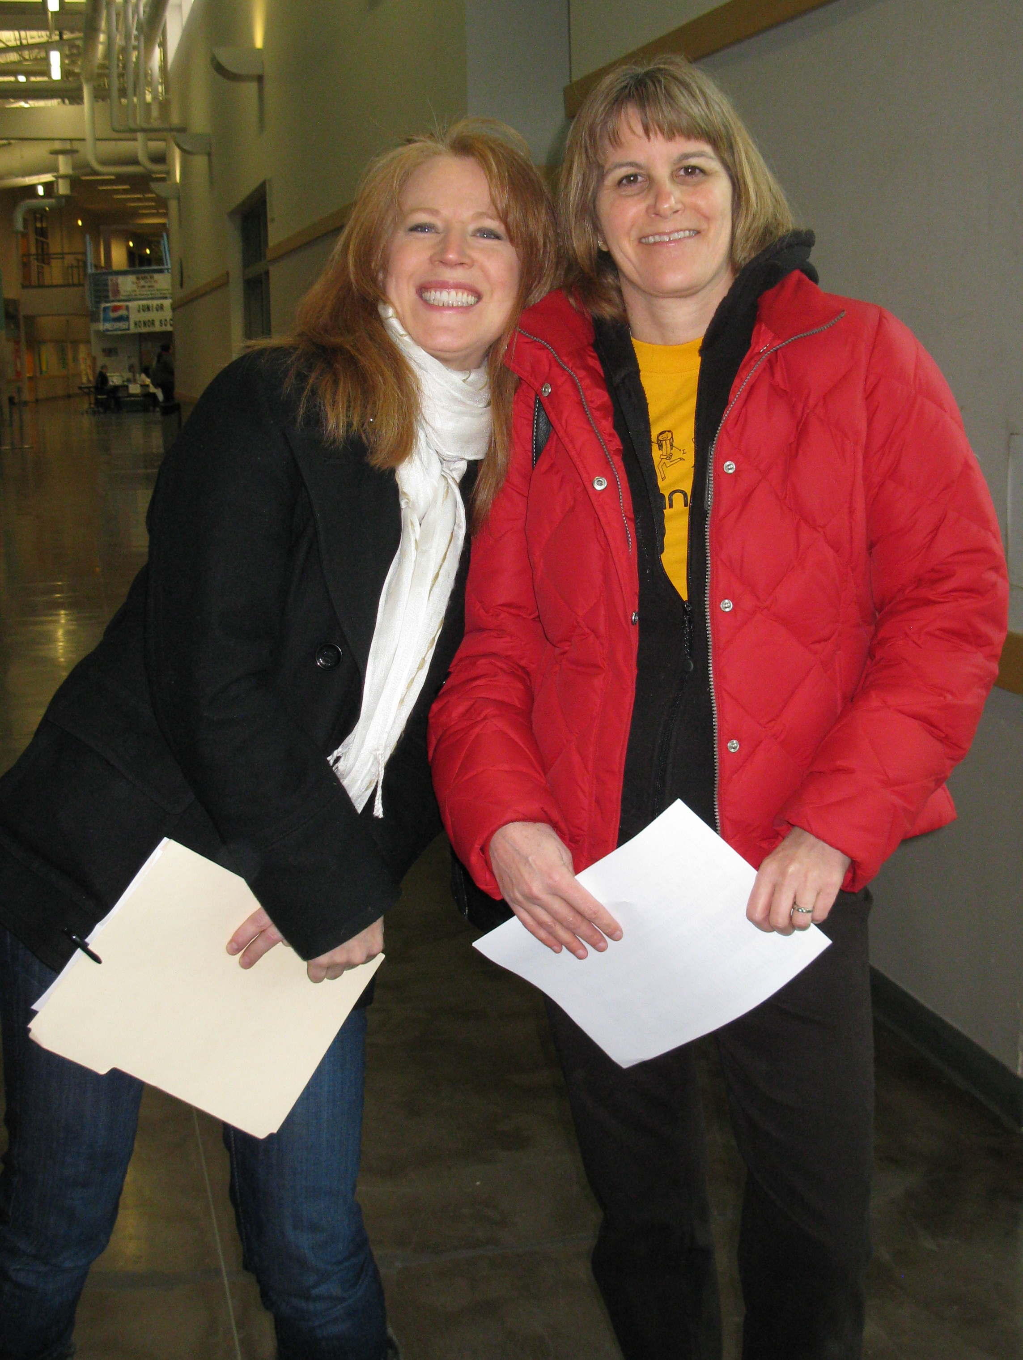
YIKES!!
You just agreed to be a Team Manager.
Now What?
Self-Confidence
Problem Solving
Team Building
Creative & Critical Thinking
Perseverance
Project Management
Risk Taking

Slide 4
DI
It’s a Whole New World
Travel Partner - Co Team Manager
Guidebooks - Challenges, Roadmap & Rules of the Road
Guide - Training, in person, on-line, phone & email

Slide 5
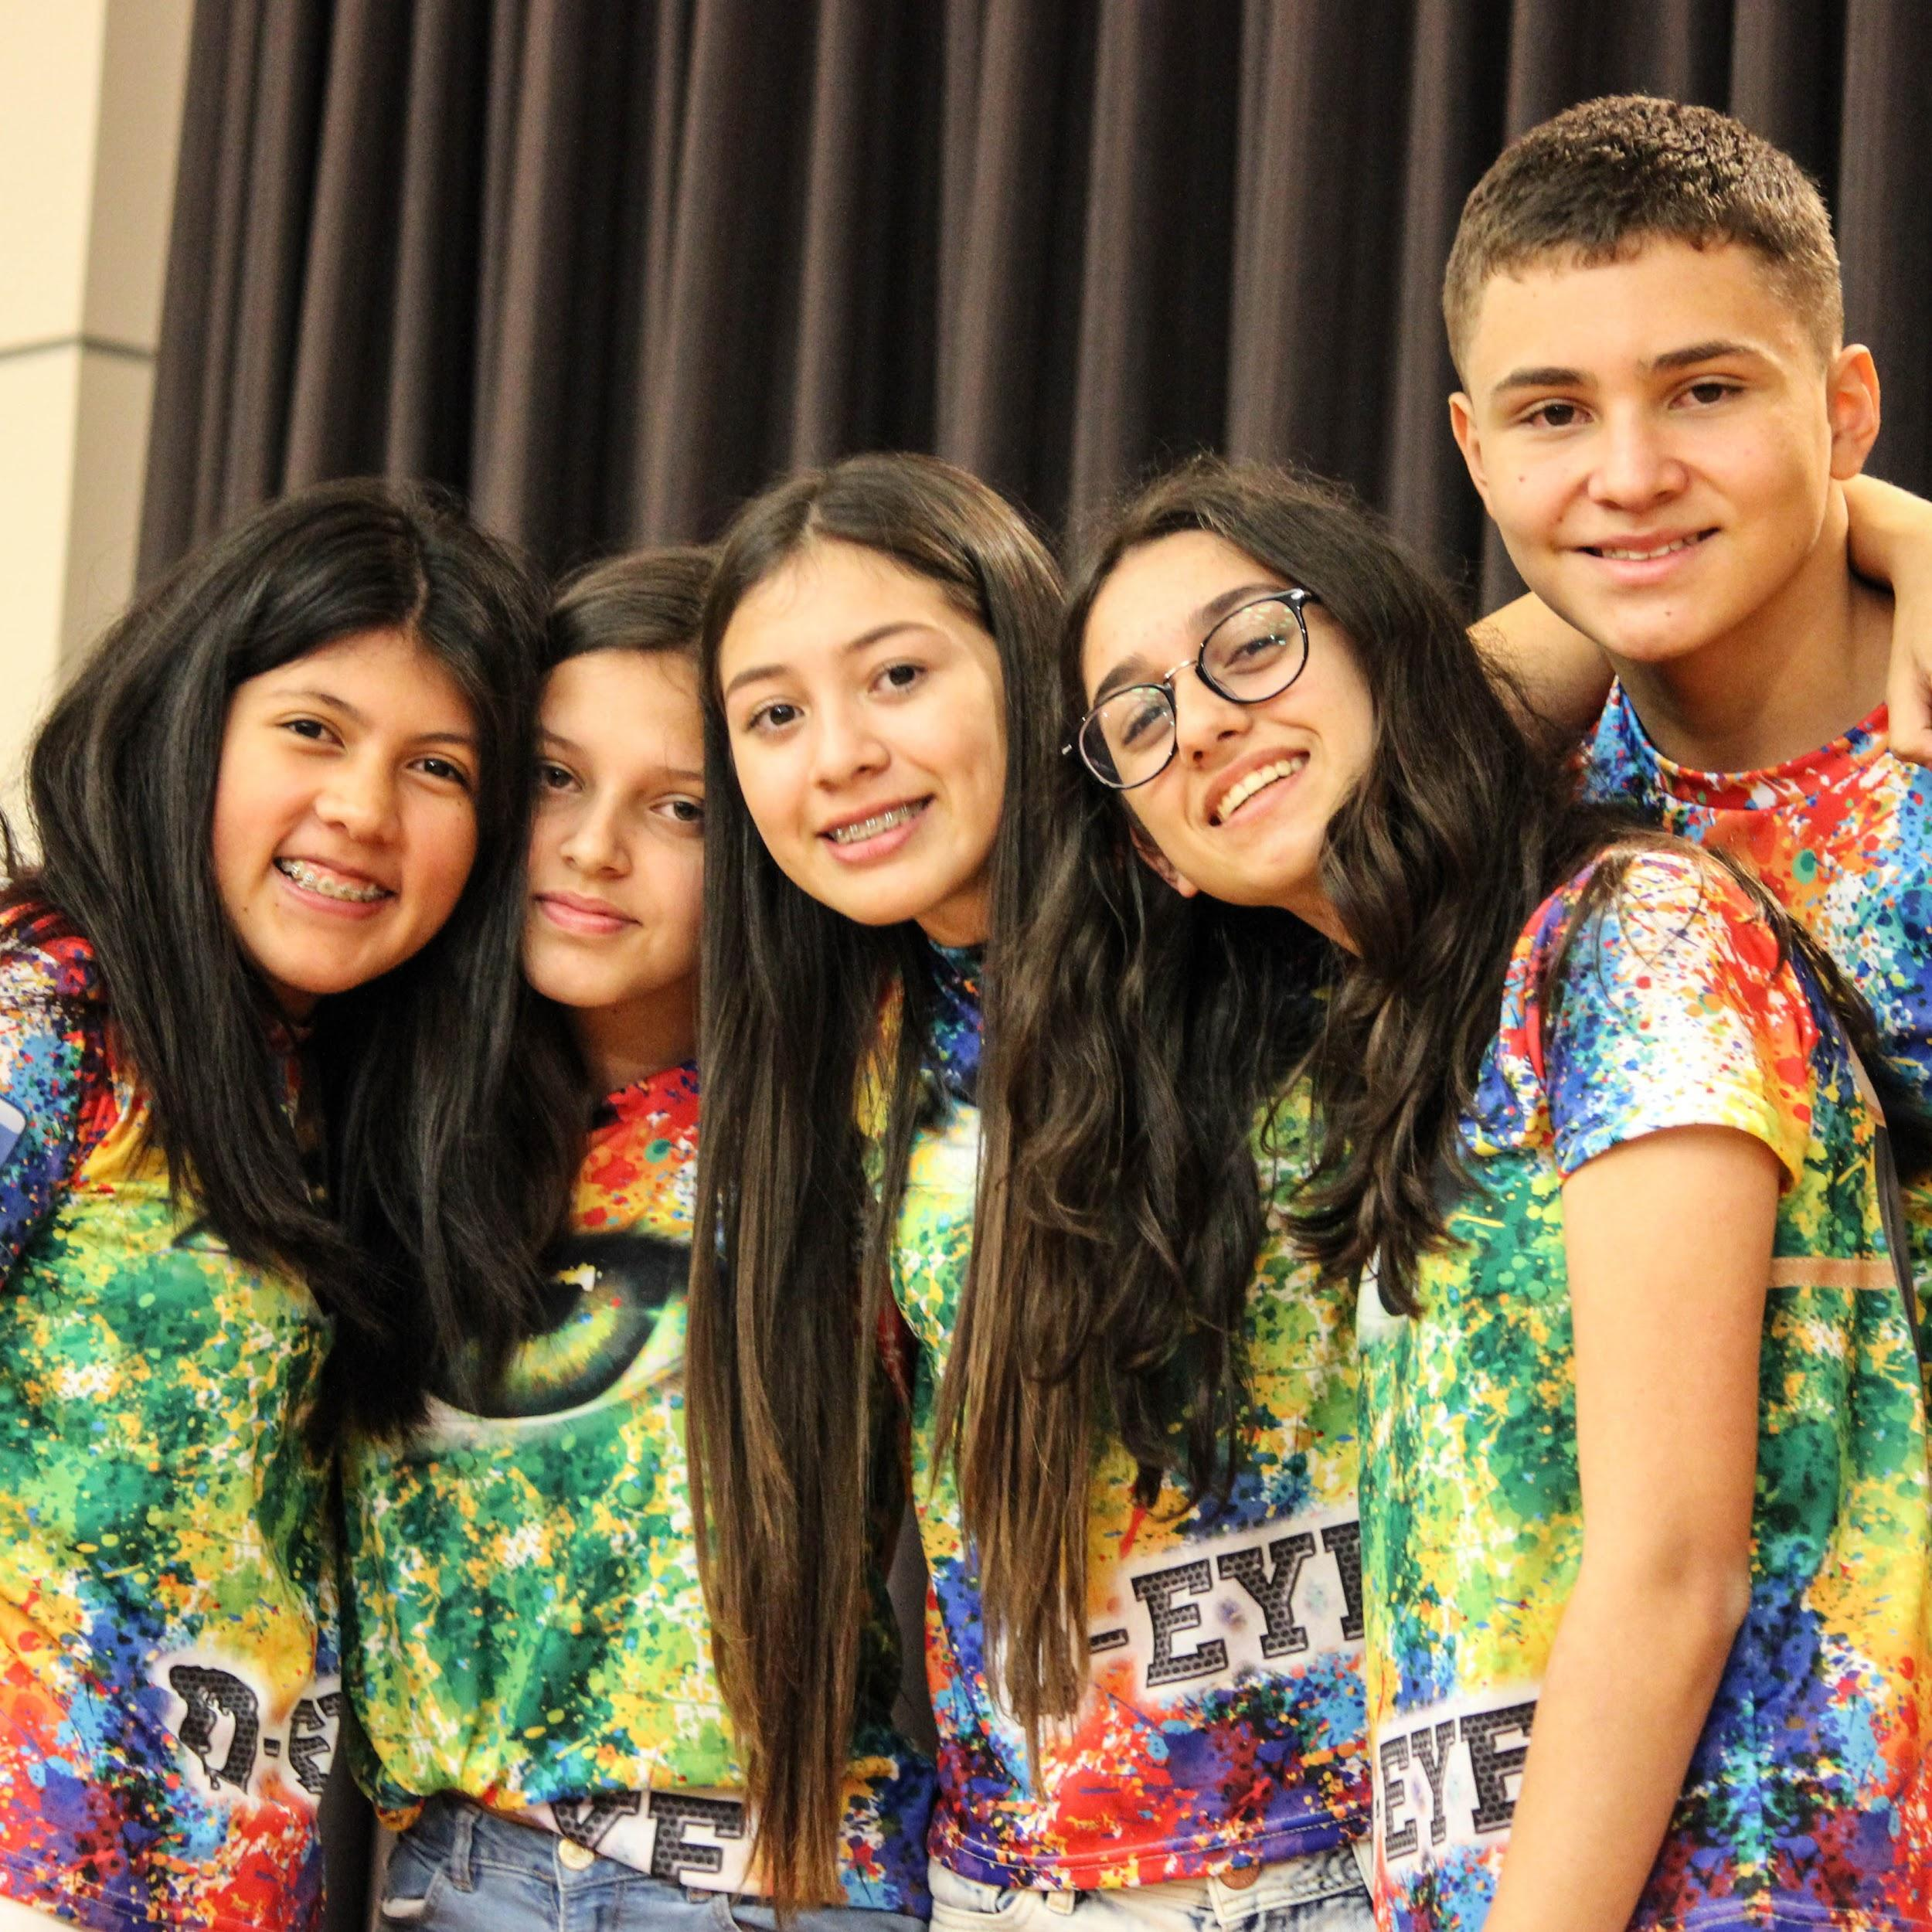
Your Role as a
Team Manager
Provide the team with a safe and creative environment with which to implement their ideas + Snacks
Guide and focus the team as THEY solve their team Challenge.
Provide access to necessary resources and teach skills the team needs to solve their Challenge
Keep outside interference from affecting the team’s solution.
Keep parents in the loop
Prepare the team for the Tournament
WHAT

Slide 6
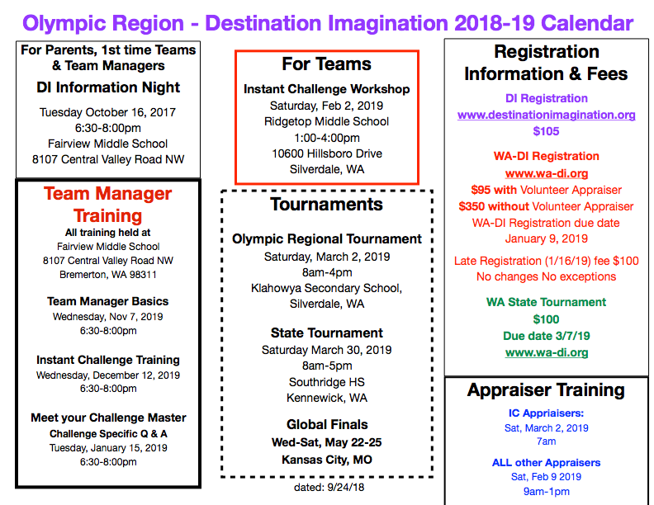

Slide 7
DI and WIN - Who’s Who?
Destination Imagination International
Produce Challenges
Conduct Global Tournament
www.destinationimagination.org
www.idodi.org
Washington Imagination Network
State Affiliate of DI
TM Training
Conduct Regional and State
Tournaments
www.wa-di.org

Slide 8
The Paperwork
Team Manager Basics
The DI Process
The DI Challenges
The Rules
What you need to know
to guide your team

Slide 9
Program Registration

Slide 10
Start a Team. https://www.wa-di.org/start-a-team.html
Click here for full instructions

Slide 11
Click on this link to take you to step-by-step DI Registration Instructions
https://www.wa-di.org/uploads/8/3/0/2/8302489/washington_destination_imagination_registration.pdf

Slide 12
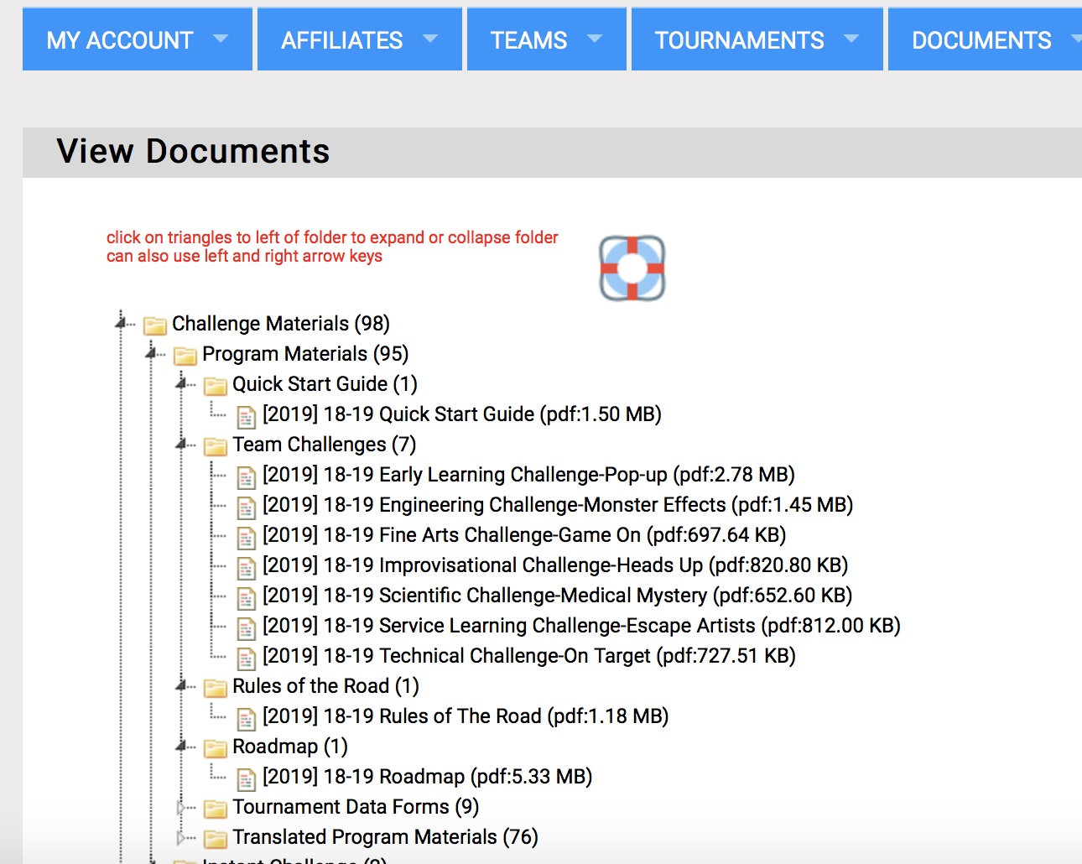
Challenges
Rule book
Step-by-step instructions

Slide 13
Start a Team. https://www.wa-di.org/start-a-team.html
New this year!

Slide 14
Background Checks
There are three ways in which Team Managers can complete a background check.
Team Managers who are teachers or school employees may submit to Washington DI their teacher license number and their current district ID annually. Please email a scan or photo of your teacher license number and current district ID to director@wa-di.org.
Team Managers who have teams in districts that require background checks may submit their clearance documentation from their school district annually to Washington DI. Check with your school office and follow their volunteer procedures. We do not need a copy of their report, just an official acknowledgment from the school that a background check is on file and been passed. Please have the school email their official acknowledgement to director@wa-di.org.
Team Managers may go through Verified Volunteers (Click Here). Team Managers can also ask Verified Volunteers to forward Washington DI their background check via the Fast Pass option if they recently completed a background check through Verified Volunteers for any other organization. The Team Manager will pay for the $15 cost of this background check. This service will report to Washington DI if you are cleared to work with children. This background check will need to be renewed annually.

Slide 15
Start in Nov/Dec
Due by Jan 9, 2019
Regional Tournament Registration
Team Manager Section
Team Member Section
Parent Permission
Volunteer Section
Payment
https://ryt.destinationimagination.org/dashboard

Slide 16
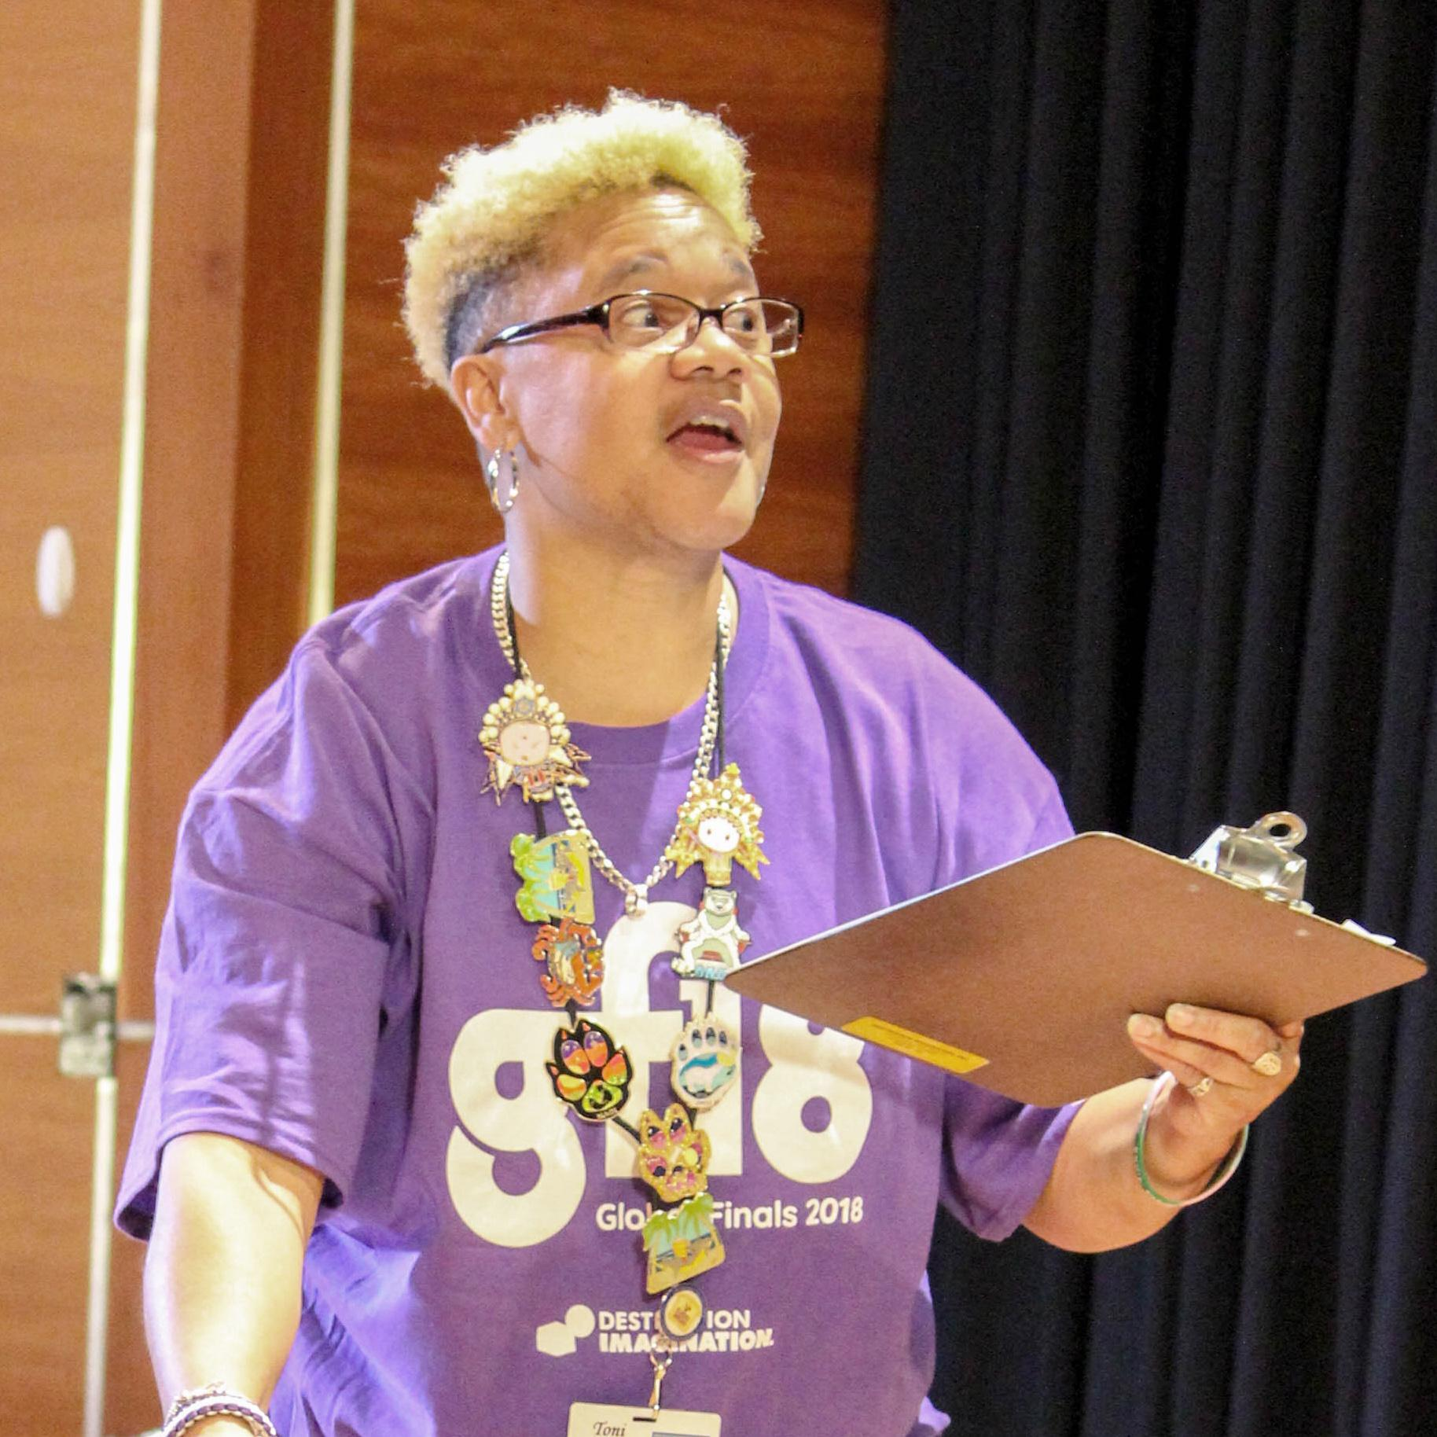
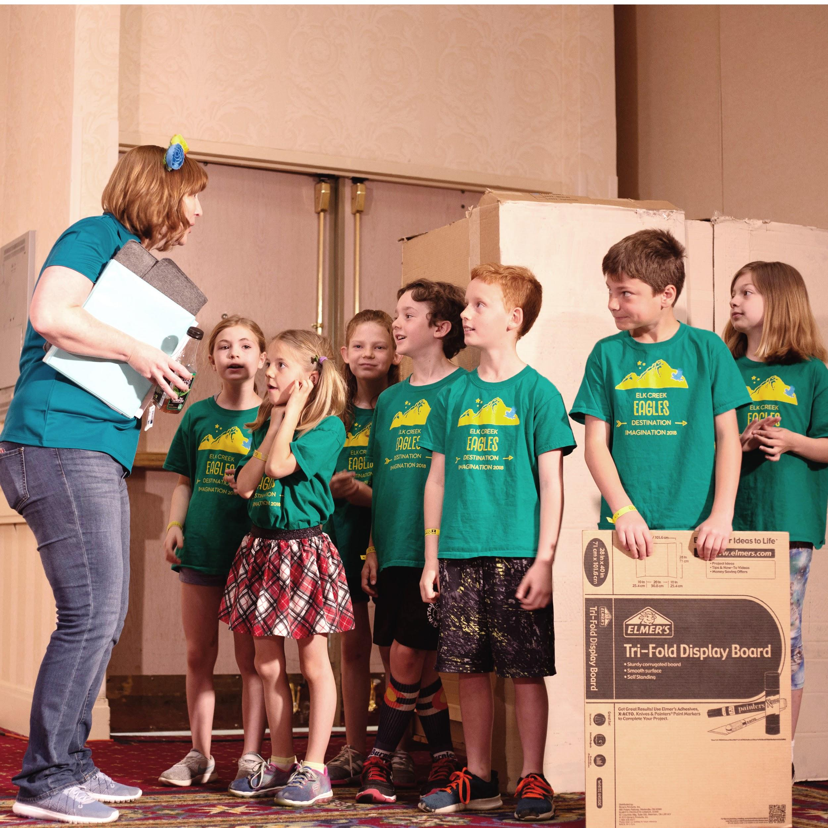
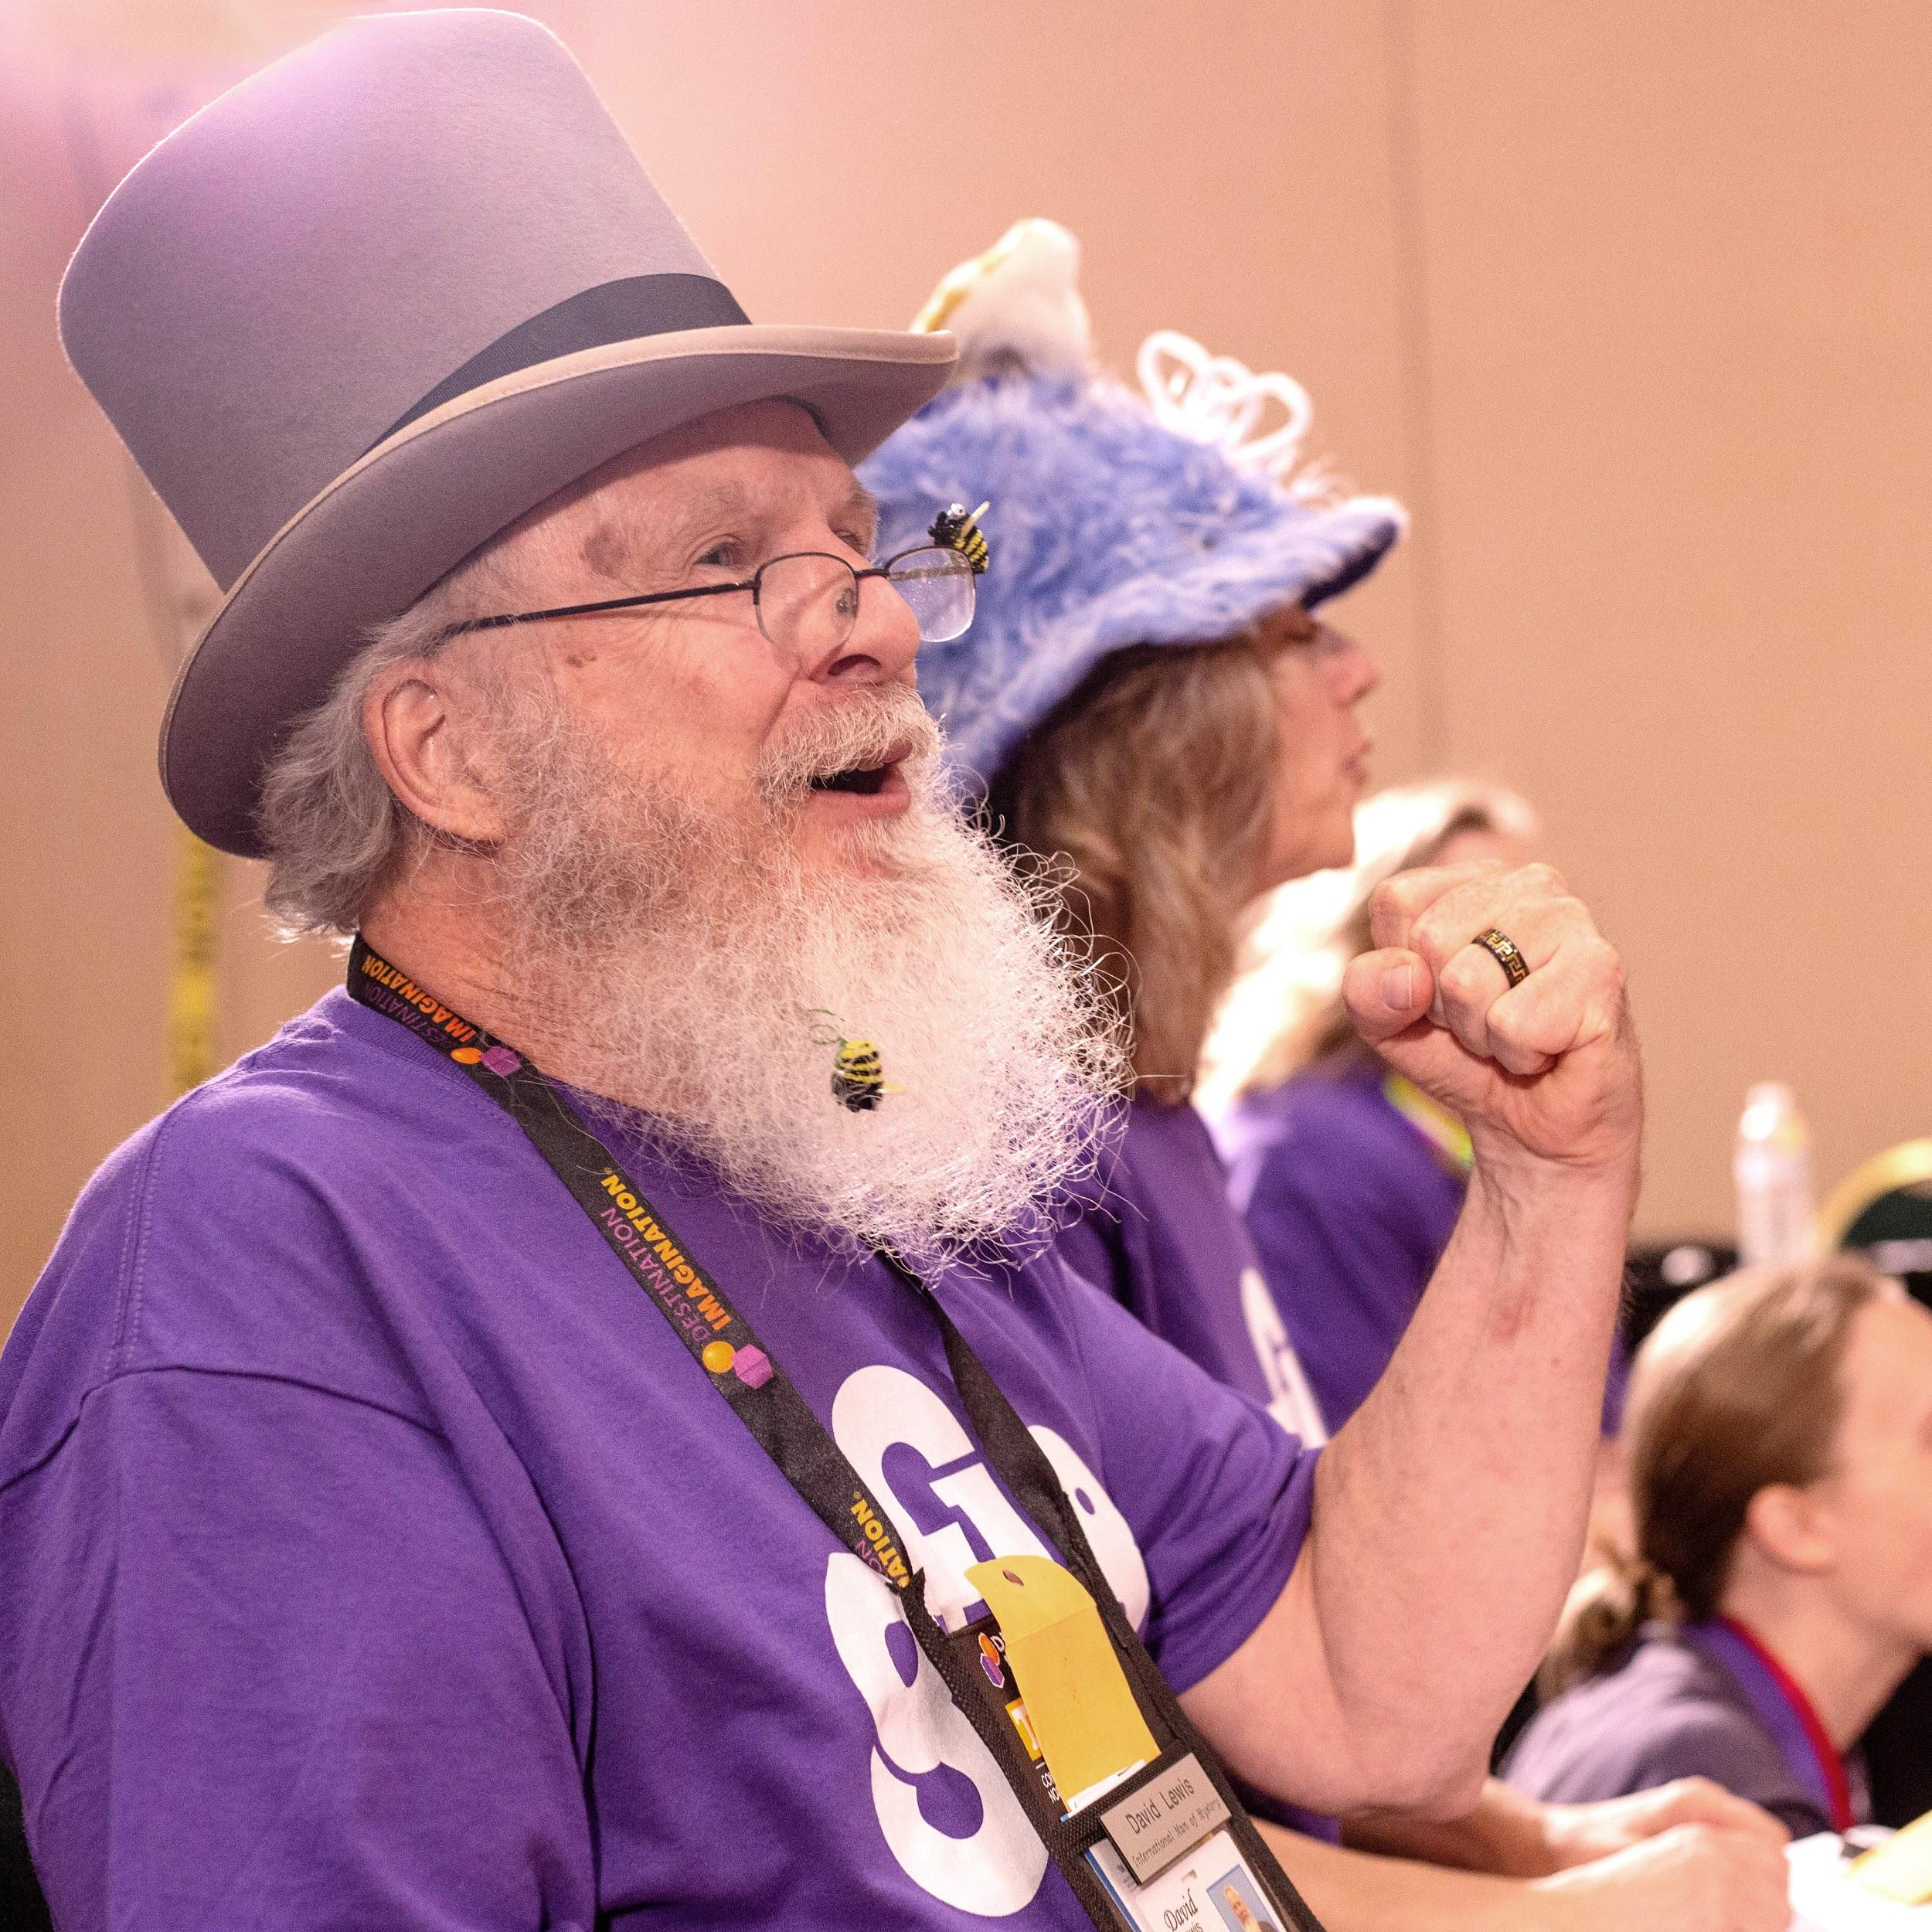
Volunteer Appraisers
WA DI tournaments could not exist without our wonderful volunteers. Each team is required to identify a volunteer to represent their team. The appraiser volunteer is trained to officiate at tournaments. It is a fun and rewarding day and requires no experience or expertise.
Volunteers are required to commit to attend the training and all day at the tournament
Volunteers will not be able to watch/appraise their own child’s performance
DI rules require that appraisers be 18+ and out of high school

Slide 17
Team Manager Basics
2 to 7 members can be on a team. (Rising Stars +)
Co-Team Manager
Meeting length and location
Snack
Communicate with Team Parents
Be Prepared – follow the Roadmap
Have a plan / set a calendar
Team Manager Training & Help
Olympic Region Calendar

Slide 18
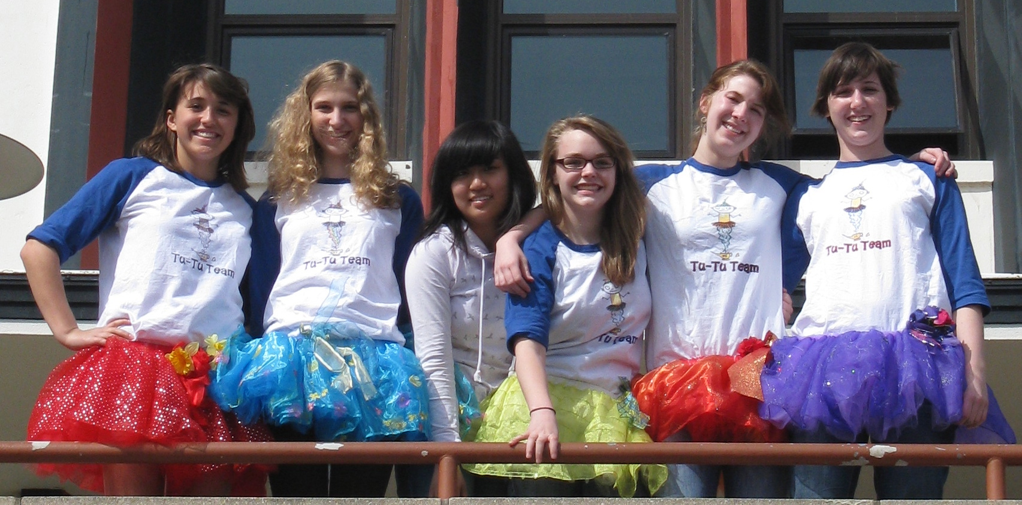
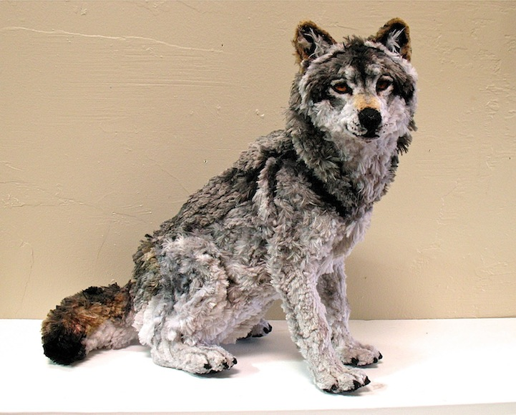
Team Manager Basics
Team Building
Team Spirit !!!!
Team Name
T-shirts
Mascot?
Stay Connected-facebook
Destination Imagination Washington State
Destination Imagination
Use the Roadmap. It is a step-by-step guide to success

Slide 19
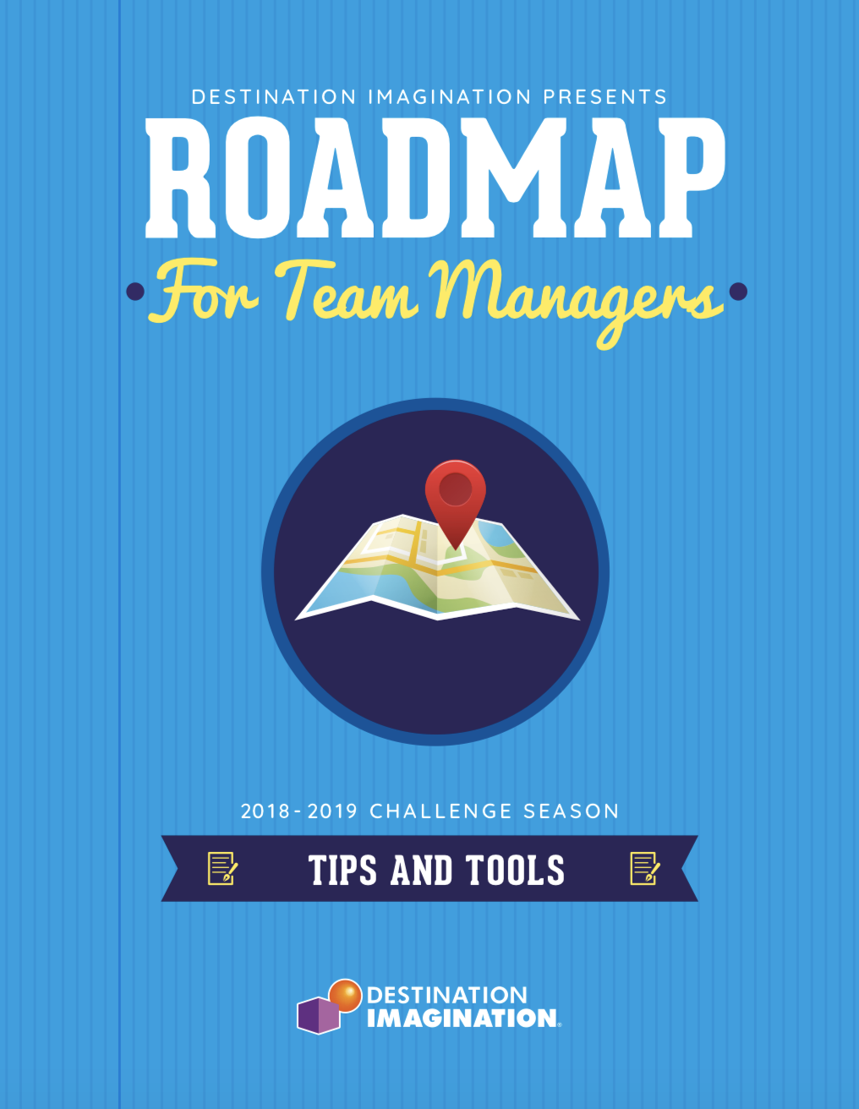
The DI Process
Creative Problem Solving (CPS) skills
Solve Real World Problems
Work together as a team
Respect for others and their ideas

Slide 20
Guiding your Team
Interference
Instant Challenges
Skills for Creative and Critical Thinking
Successful Teams
Project Management

Slide 21
The Team Challenge
The Team
Chooses a Challenge
Go to First Look document
https://www.destinationimagination.org/challenge-program/2018-19-challenge-previews/

Slide 22
THE TEAM CHALLENGES

Slide 23
The Rules
All the Rules, Procedures, and (some) of the forms needed to participate at a DI tournament
Go to RotR index

Slide 24
Site Specific Restrictions for Klahowya Secondary School (KSS)
Dry ice, helium balloons and smoke/fog machines are prohibited. (They set off the smoke alarms.)
CKSD district rules pertaining to drugs, alcohol and tobacco are in effect. (Don’t do it!)
CKSD does not endorse or support gratuitous violence. If a team needs to depict a weapon, that weapon must be theatrical in nature, team created and/or obviously benign.
Any teams performing in the Gym, are reminded that it is their responsibility to design a safe solution that will not damage the Presentation Site (gym floor)
Teams may use KSS guest WiFi

Slide 25
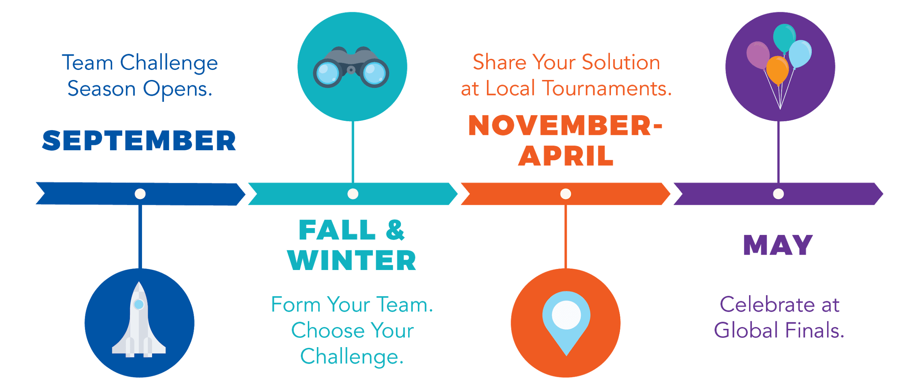
Tournament Season at a Glance
Teams typically spend two to four months planning, developing, and practicing their Challenge solutions.
They exhibit their creativity and innovation by showcasing their Challenge solutions in front of live audiences at local tournaments.
WHAT

Slide 27
Questions
Thank you! For additional information, please contact:
Marcia Rubenstein
Olympic Regional/Tournament Director
OlympicRD@wa-di.org
360-908-0454
www.wa-di.org
www.destinationimagination.org
HOW

