Slide 1
Region B Tournament
February 27, 2021

Slide 2
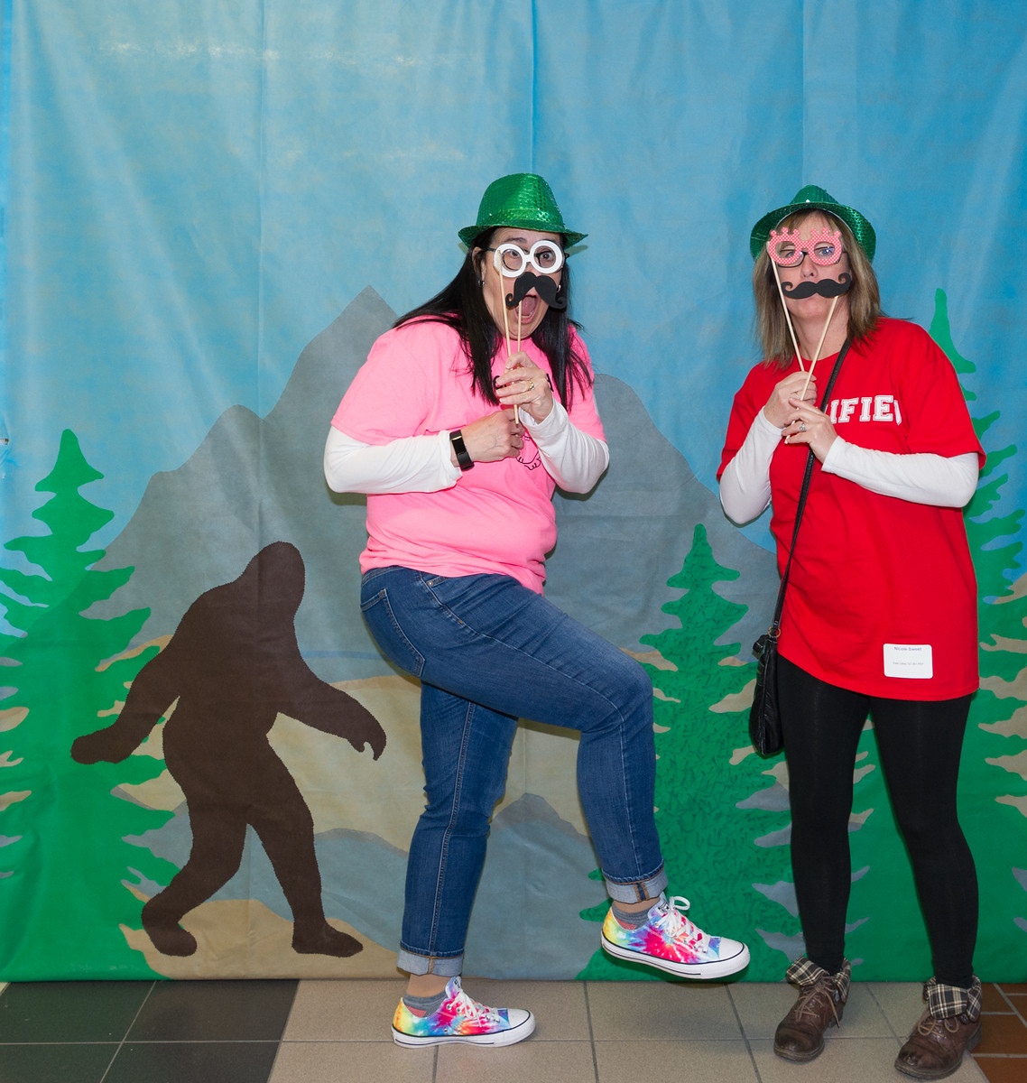
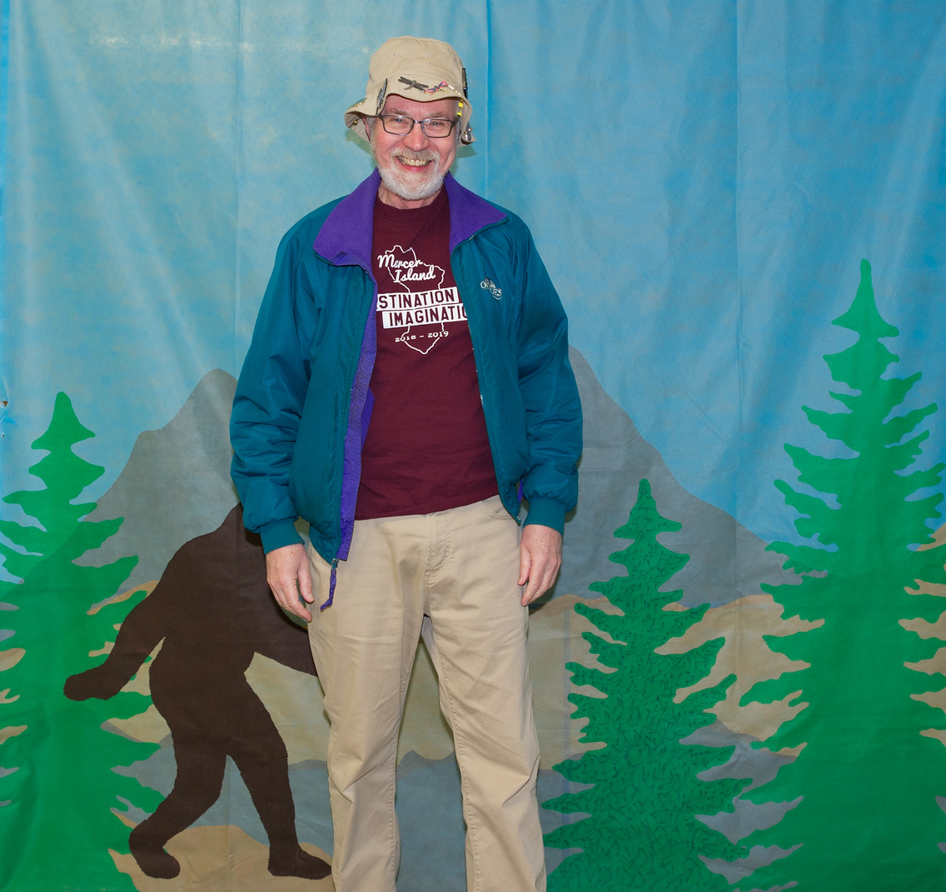
Thank You Team Managers!

Slide 3
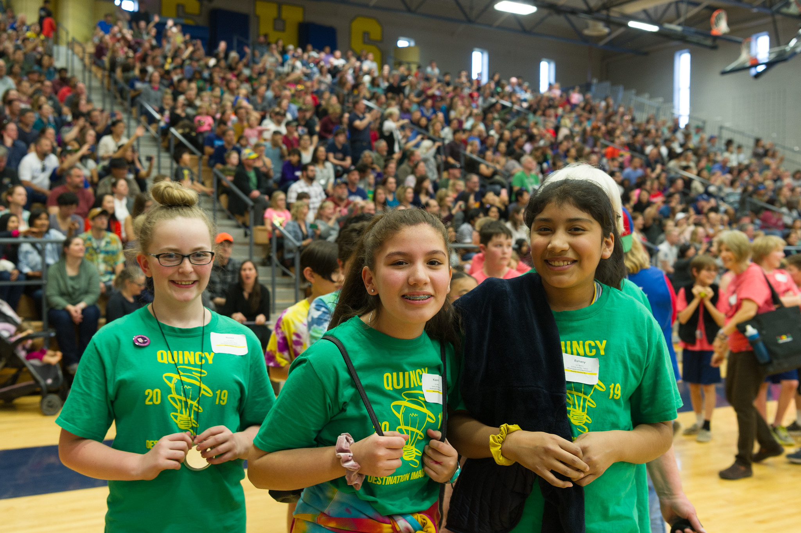
Thank You Parents & Supporters!

Slide 4
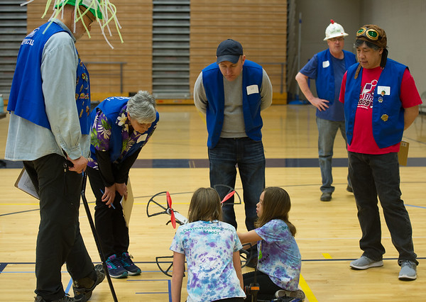
Thank You
Volunteers!

Slide 5
Due to lower number of teams this year, all teams will advance to the Affiliate Tournament. Registration for the Affiliate Tournament opens on February 27 and closes o March 4.

Slide 7
Technical Challenge
Elementary Level 2nd Place
147-12772
Quest Masters
Seabury - Tacoma

Slide 8
Technical Challenge
Elementary Level 1st Place
147-54879
Clever Fuzzy Cats
Mt. Pleasant School - Washougal

Slide 9
Technical Challenge
Middle Level 3rd Place
147-62532
St. Rose School
Longview

Slide 10
Technical Challenge
Middle Level 2nd Place
147-27583
Secret Sarcastic Sloth Society
Mercer Island

Slide 11
Technical Challenge
Middle Level 1st Place
147-22115
St. Rose School
Longview

Slide 12
Technical Challenge
Secondary Level 2nd Place
147-39445
Mystery High
Mercer Island

Slide 13
Technical Challenge
Secondary Level 1st Place
147-53580
7-bit
Mercer Island

Slide 14
Renaissance Award
147-53580 7-bit
Mercer Island
Used 3-D CAD and 3-D printing to form actuator “finger” mechanisms that plucked different notes on a Ukulele.
Built pad printer made from hand-made solenoids, ink pads, and micro-controller to print key clues for solving crime.
Novel video editing of green screen stitched team members at remote locations together via layering, making it appear they were all together.
Pixel art background made to look like classic 80’s video game and background music was similar in character.

Slide 16
Scientific Challenge
Elementary Level 1st Place
147-90405
You Know What, Let’s Skip ‘Em
Mercer Island

Slide 17
Scientific Challenge
Middle Level 1st Place
147-54050
7 Wonders
Mercer Island

Slide 18
Renaissance Award
147-54050 7 Wonders
Mercer Island
This award is being given to the team for their impressive coding skills. The team coded 3 animation scenes using Java Script and over 300 lines of code. Very impressive! Great job!

Slide 19
Scientific Challenge
Secondary Level 1st Place
147-21941
Flannel Beans
Bremerton

Slide 21
Fine Arts Challenge
Elementary Level 2nd Place
147-43235
The Dancing Taco Cats
Bainbridge Island

Slide 22
Fine Arts Challenge
Elementary Level 1st Place
147-59505
TigerS
Bellevue

Slide 23
Fine Arts Challenge
Middle Level 4th Place
147-73690
DaBugs
Mt. Pleasant School - Washougal

Slide 24
Fine Arts Challenge
Middle Level 3rd Place
147-40805 The Chicken Squad – Silverdale
147-68970 Musically Inclined – Mercer Island

Slide 25
Fine Arts Challenge
Middle Level 2nd Place
147-85138
Heroic Villains
Mercer Island

Slide 26
Fine Arts Challenge
Middle Level 1st Place
147-98544
Technical Difficulties
Mercer Island

Slide 28
Improvisational Challenge
Secondary Level 2nd Place
147-72535
Dark Mark
Mercer Island

Slide 29
Improvisational Challenge
Secondary Level 1st Place
147-95267
Mischief Mismanaged
Bainbridge Island

Slide 31
Engineering Challenge
Middle Level 1st Place
147-62311
We Haven’t Decided Yet
Mercer Island

Slide 32
Engineering Challenge
Secondary Level 1st Place
147-27976
Hark Medlee
Mercer Island

Slide 33
DaVinci Award
147-27976 Mark Medlee
Mercer Island
Not only did this team meet the required challenge of every team member being in a separate video window/separate room, but they also used it to enhance the presentation of their solution. They achieved this without special editing or video effects. They took the challenges of video instant challenge and made it work to their advantage.

Slide 35
Service Learning Challenge
Middle Level 1st Place
147-29541
Didiots
Mercer Island

Slide 36
Service Learning Challenge
Secondary Level 1st Place
147-09346
A Toast to Bread
Mercer Island

Slide 37
Congratulations Teams!

