Slide 1
Region A Tournament
February 27, 2021

Slide 2
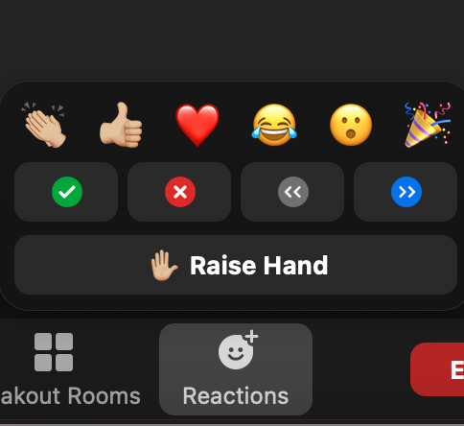
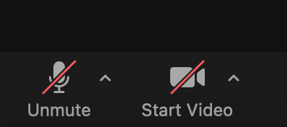
Zoom Tips:
Silent celebrations
Use your reactions!
Cheer
During the presentation, we’ll call for cameras off and cameras on
It is your choice to turn on your camera
Zoom doesn’t give control over who you are next to
To make this work, everyone will stay on mute, the chat is disabled

Slide 3
Format for award ceremony
Thanking those who helped
Honoring our oldest participants - what has DI meant to you?
Rising Stars
Team members vote on which challenge to see next using Zoom controls
Announcers read the results for the chosen challenge
Team members answer a question about their DI experience
Announcers show the results
A new challenge is chosen … until there aren’t any left
Special Awards

Slide 4
One more thing…. About the State competition…..

Slide 5
ALL TEAMS ARE GOING TO STATE!!!!!!

Slide 6
Cameras Off Please

Slide 7
2020-21 State Challenge Masters
George Chin Bruce Richards
Amanda Lemley Paul Fisher
Shannon Lubetich Nicole Tamura
Samantha Powers Rachael Clayton

Slide 8
Alumni Recogninition These are former DI team members who are now volunteering for DI:

Slide 9
Amanda Boomer - Appraiser
Amy Curneen - RCM Fine Arts
Jeff Butz - Appraiser
Joost deNijs - Appraiser
Jackson Chin - Appraiser
Nick Andrews - RCM Scientific
Shannon Lubetich - ACM Fine Arts
Samantha Powers - ACM Improv
Kirsten Wollem - RCM Fine Arts
Ayan Gupta - WA DI Communications
Jenn Ginder - Regional Tournament Director

Slide 10
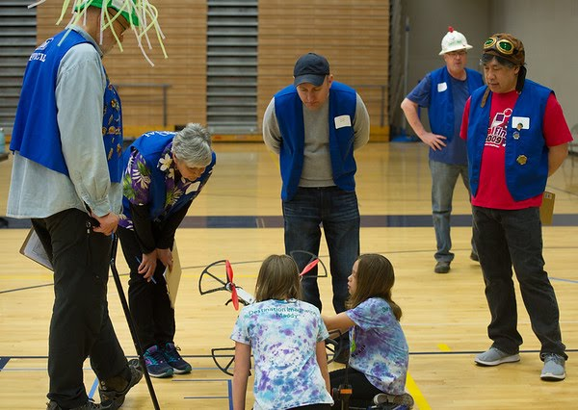
Thank You
Volunteers!

Slide 11
Thank You Parents & Supporters!
Team Members: Give your folks a shout out in the space provided. Use your reactions.
Notes:
🍐 This is a Pear Deck Text Slide
🍐 To edit the type of question, go back to the "Ask Students a Question" in the Pear Deck sidebar.

Slide 12
Thank You Team Managers!
Team Members: what do you appreciate most about your team manager? Be sure to use their name in what you say.
Notes:
🍐 This is a Pear Deck Text Slide
🍐 To edit the type of question, go back to the "Ask Students a Question" in the Pear Deck sidebar.

Slide 13
Cameras Off Please

Slide 14
How many years have you been doing DI?
Notes:
🍐 This is a Pear Deck Number Slide
🍐 To edit the type of question, go back to the "Ask Students a Question" in the Pear Deck sidebar.

Slide 15
Thank you, seniors.

Slide 16
Cameras on for …...

Slide 17
Rising Stars Challenge
30712
Medina Elementary
Bellevue, WA

Slide 18
Rising Stars Challenge
81556
Creative Thinkers
Redmond, WA

Slide 19
Seniors, turn your cameras on and give the Rising Stars a wave and/or use a reaction!

Slide 20
Cameras Off Please

Slide 21
Cameras on for …...

Slide 22
Technical Challenge
Elementary Level 2nd Place
66689
Seattle Supernova
Redmond, WA

Slide 23
Technical Challenge
Elementary Level 1st Place
03863
Flaming Eiffel
Bellevue, WA

Slide 24
Technical Challenge
Middle Level 2nd Place
63230
Avatar: Einstein
Medina, WA

Slide 25
Technical Challenge
Middle Level 2nd Place
15756
Dragonflies
Mukilteo, WA

Slide 26
Technical Challenge
Middle Level 1st Place
49751
D. Inventors
Redmond, WA

Slide 27
Technical Challenge
Senior Level 1st Place
07251
N/A
Bellevue, WA

Slide 28
Cameras Off Please

Slide 29
What was your favorite part of DI this year?
Notes:
🍐 This is a Pear Deck Text Slide
🍐 To edit the type of question, go back to the "Ask Students a Question" in the Pear Deck sidebar.

Slide 30
Cameras on for …...

Slide 31
Scientific Challenge
Middle Level 2nd Place
85338
Radioactive Lightbulbs
Seattle, WA
Notes:
🍐 This is a Pear Deck Text Slide
🍐 To edit the type of question, go back to the "Ask Students a Question" in the Pear Deck sidebar.

Slide 32
Cameras Off Please

Slide 33
My favorite DI challenge I’ve ever done was…. Because ….
Notes:
🍐 This is a Pear Deck Text Slide
🍐 To edit the type of question, go back to the "Ask Students a Question" in the Pear Deck sidebar.

Slide 34
Cameras on for …...

Slide 35
Fine Arts Challenge
Middle Level 3rd Place
31289
Flying Hippodillos
Kirkland, WA

Slide 36
Fine Arts Challenge
Middle Level 2nd Place
79423
We’reAllMadHere
Issaquah, WA

Slide 37
Fine Arts Challenge
Middle Level 1st Place
00592
In All KAPS
Bellevue, WA

Slide 38
Fine Arts Challenge
Senior Level 2nd Place
51245
Duct Duct Goose
Clyde Hill, WA

Slide 39
Fine Arts Challenge
Middle Level 1st Place
02147
The Golden Trio
Redmond, WA

Slide 40
What did your team create this year that you are most proud of?
Notes:
🍐 This is a Pear Deck Text Slide
🍐 To edit the type of question, go back to the "Ask Students a Question" in the Pear Deck sidebar.

Slide 41
Cameras Off Please

Slide 43
Improvisational Challenge
Elementary Level 1st Place
08814
The Imposters
Bellevue, WA

Slide 44
Improvisational Challenge
Middle Level 2nd Place
73308
Supreme Swordfish
Redmond, WA

Slide 45
Improvisational Challenge
Middle Level 1st Place
76869
Masterminds
Redmonds, WA

Slide 46
Improvisational Challenge
Secondary Level 1st Place
03260
The Invincible Improvers
Redmond, WA

Slide 47
Other than duct tape, what is the most essential thing to have in a team’s DI kit?
Notes:
🍐 This is a Pear Deck Text Slide
🍐 To edit the type of question, go back to the "Ask Students a Question" in the Pear Deck sidebar.

Slide 48
Cameras Off Please

Slide 49
Cameras on for ….

Slide 50
Engineering Challenge
Elementary Level 3rd Place
92842
Covid Defenders
Bellevue, WA

Slide 51
Engineering Challenge
Elementary Level 2nd Place
65950
None
Mukilteo, WA

Slide 52
Engineering Challenge
Elementary Level 1st Place
45999
Fab 5
Bellevue, WA

Slide 53
Give a team member a compliment.
Notes:
🍐 This is a Pear Deck Text Slide
🍐 To edit the type of question, go back to the "Ask Students a Question" in the Pear Deck sidebar.

Slide 54
Cameras Off Please

Slide 55
Cameras on for …

Slide 56
Service Learning Challenge
Elementary Level 2nd Place
28495
Magnetic Ice
Seattle, WA

Slide 57
Service Learning Challenge
Elementary Level 1st Place
65689
We’re A M.A.S.K
Redmond, WA

Slide 58
Service Learning Challenge
Middle Level 1st Place
04600
Cool Green Lighting
Woodway, WA

Slide 59
Service Learning Challenge
Senior Level 4th Place
93651
5 Star Friends (est. 2017)
Medina, WA

Slide 60
Service Learning Challenge
Senior Level 3rd Place
30031
Clown Daddies
Sammamish, WA

Slide 61
Service Learning Challenge
Senior Level 2nd Place
47670
Five Star Friends
Bellevue, WA

Slide 62
Service Learning Challenge
Senior Level 1st Place
31340
Inflatable Falling Stars
Bellevue, WA

Slide 63
Cameras Off Please

Slide 64
What are you looking forward to for next year’s tournament other than meeting in person?
Notes:
🍐 This is a Pear Deck Text Slide
🍐 To edit the type of question, go back to the "Ask Students a Question" in the Pear Deck sidebar.

Slide 65
If you’re called, turn your camera on!
This award is offered for exceptional skill in the areas of engineering, design, or performance. Nominations should give examples of outstanding skills in the areas of engineering, design, or performance demonstrated by the team/individual. This award is offered for skill rather than creativity.

Slide 66
Renaissance Award
The Next Level
66689
Cool Green Lightening

Slide 67
Renaissance Award
Instant Challenge
04600
Seattle Super Nova

Slide 68
Renaissance Award
Project Outreach
31340
Inflatable Falling Stars

Slide 69
Renaissance Award
Epic Remix
02147
The Golden Trio

Slide 70
Renaissance Award
Epic Remix
00592
In All KAPS

Slide 71
Renaissance Award
In Theory
85238
Radioactive Lightbulbs

Slide 72
Renaissance Award
The Next Level
63230
Avatar: Einstein

Slide 73
Renaissance Award
The Next Level - IC
49751
D. Inventors

Slide 74
If you’re called, turn your camera on!
This award is offered for exceptional creativity (not skill or talent), a unique approach to the problem, and/or risk taking. The solution need not be successful to qualify for this award. This is Destination Imagination's most prestigious award and should not be given lightly.

Slide 75
DaVinci Award
The Next Level
03863
Flaming Eiffel

Slide 76
DaVinci Award
Project Outreach
65689
We’re a M.A.S.K.

Slide 77
DaVinci Award
The Next Level
07251
N/A

Slide 78
DaVinci Award
The Next Level - IC
03863
Flaming Eiffel

Slide 79
DaVinci Award
The Next Level -IC
07251
N/A

Slide 80
What’s Next
Directions will be sent out to you afterwards with score breakdowns.
This will take a little while to send out
Medals and Special Award sheets will be sent out later by Wa. DI
You need to register for State by March 4th
This link will also be in the email
The State tournament results are announced April 3rd

