Slide 1
Eastern Regional Tournament
February 27, 2021

Slide 2
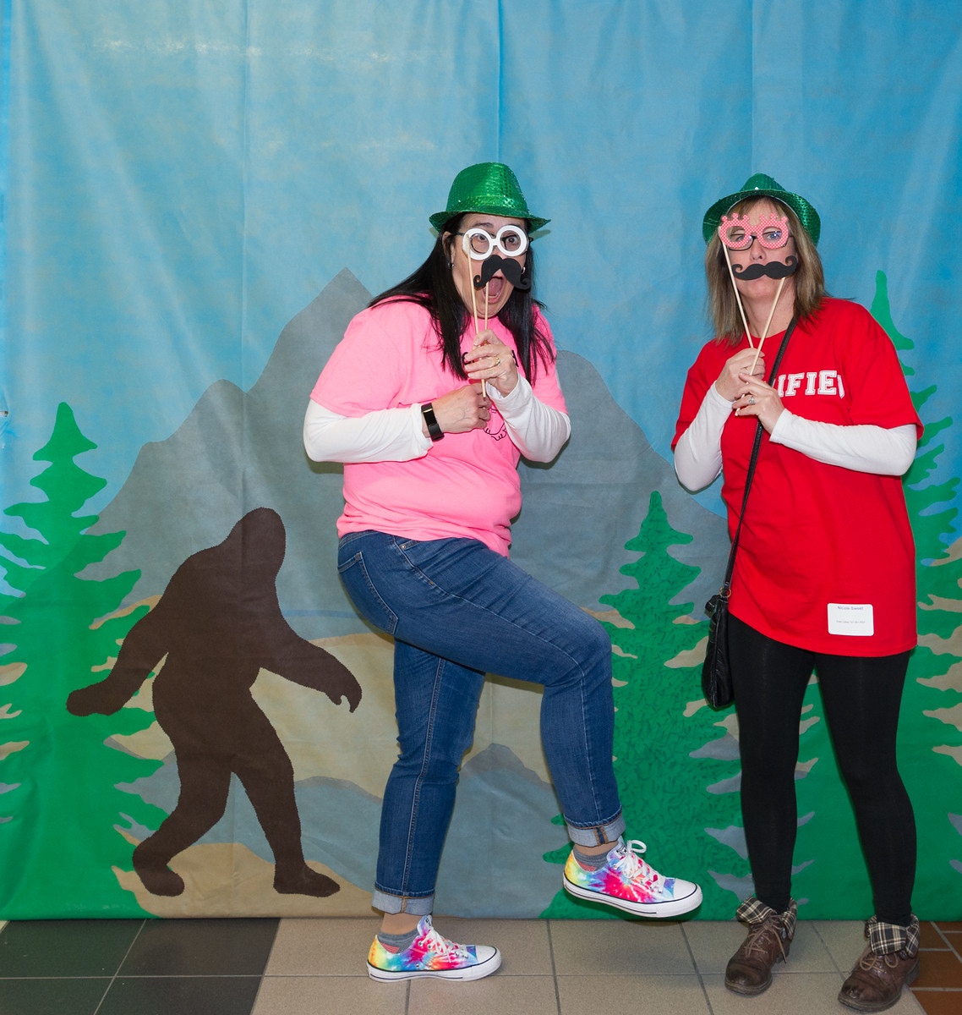
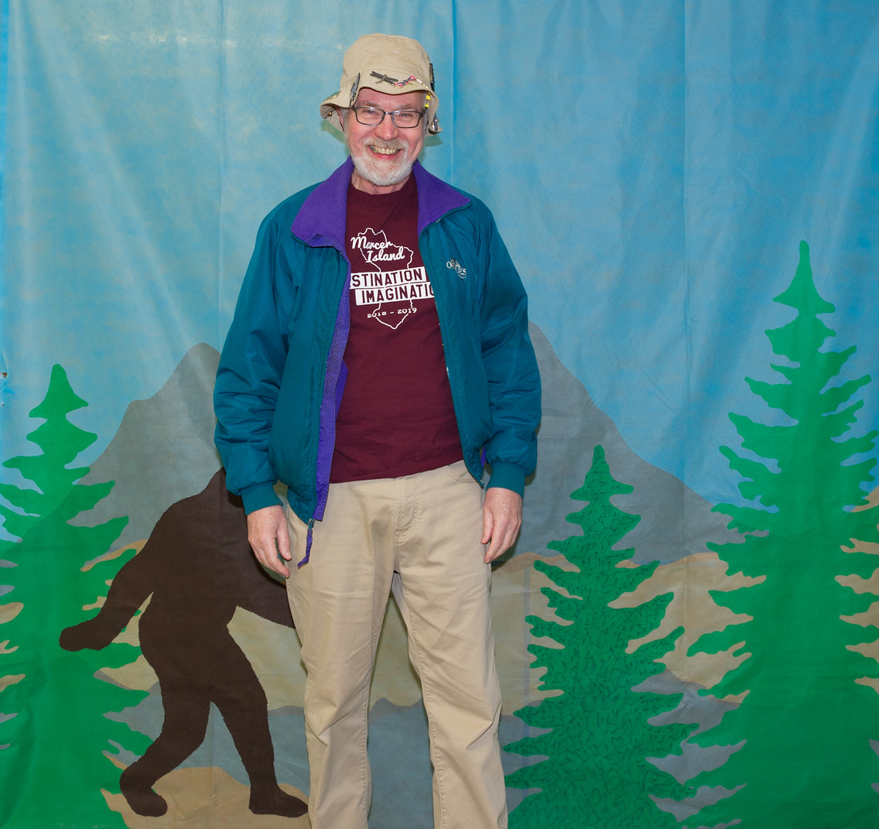
Thank You Team Managers!

Slide 3
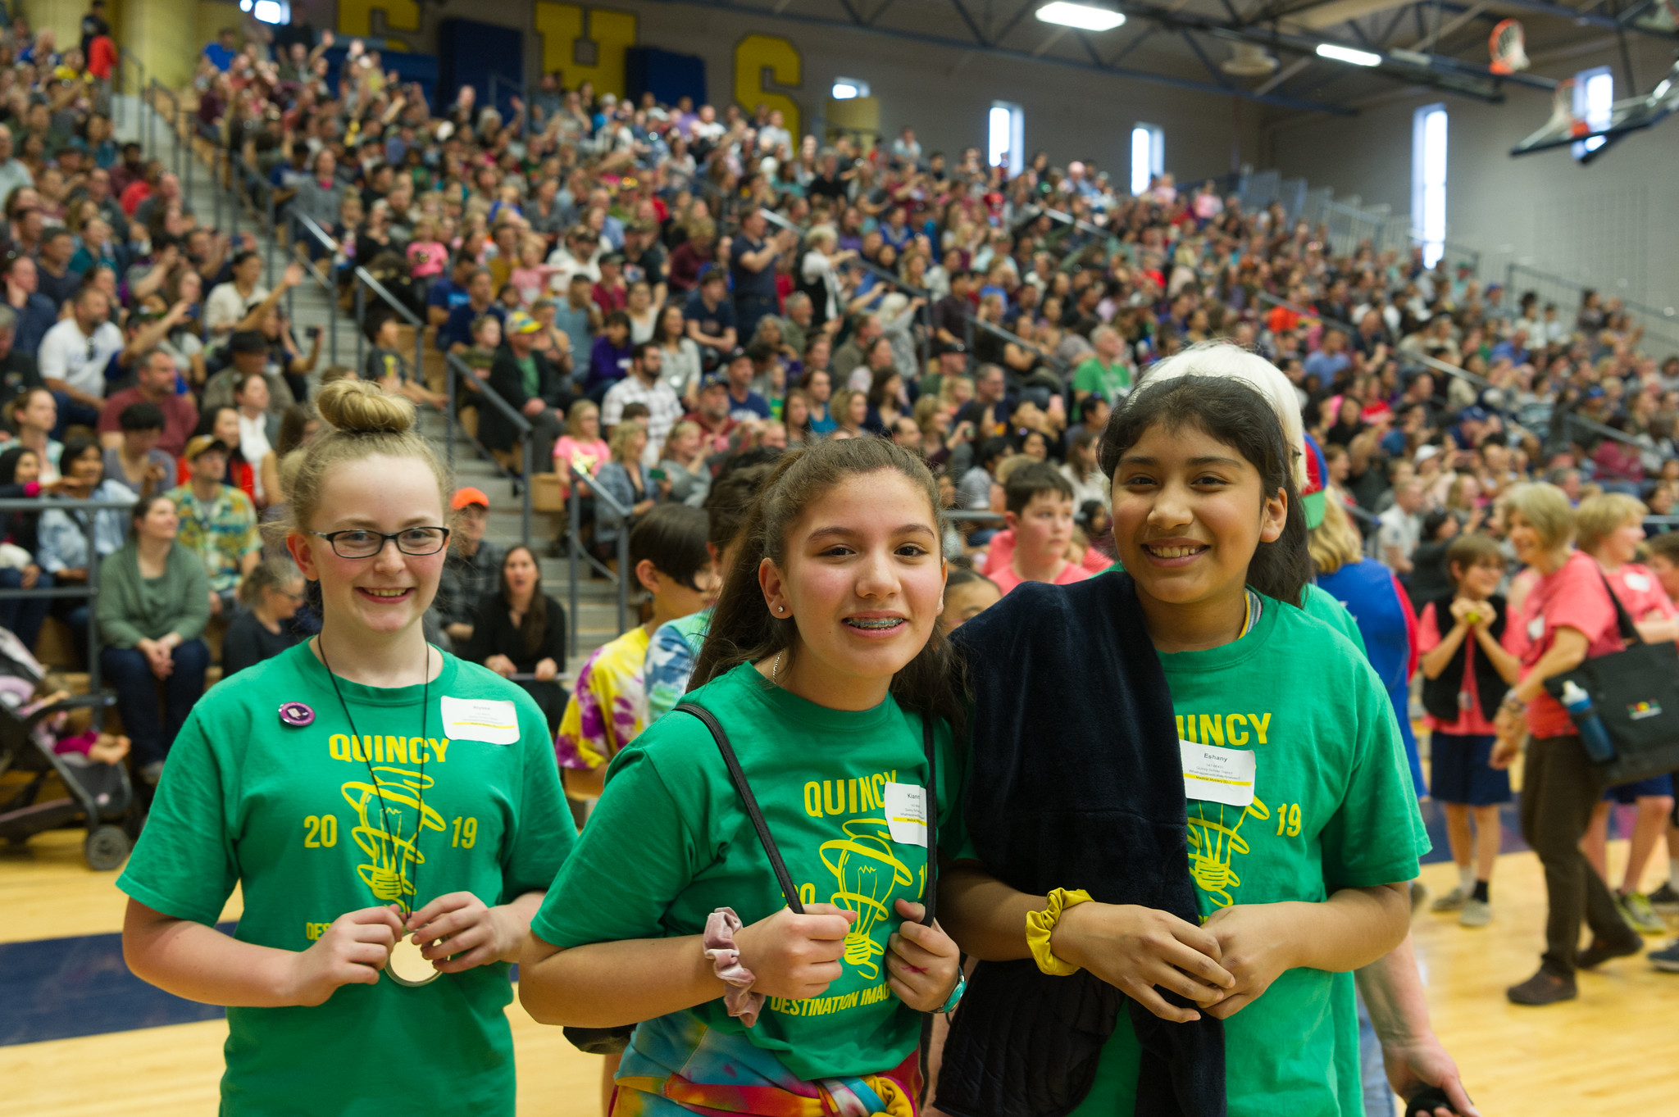
Thank You Parents & Supporters!

Slide 4
Alumni Recogninition These are former DI team members who are now volunteering for DI:

Slide 5
Amanda Boomer - Appraiser
Rachael Clayton - RCM Instant Challenge
Jackson Chin - Appraiser
Mickinley Chin - Appraiser
Tiffanie Eyre - Volunteer
Bob Kestell - RCM Engineering
Amanda Lemley - RCM Scientific
Christina Perry - RCM Fine Arts
Alyssa St. Hilaire - Team Manager
Stacia Bruner Scharff - Appraiser

Slide 6
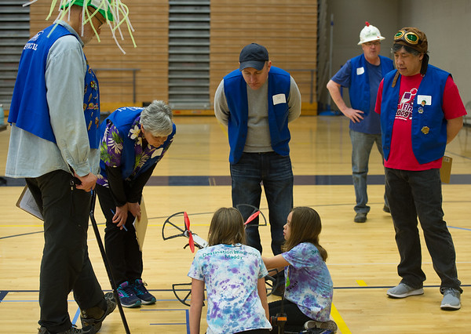
Thank You
Volunteers!

Slide 7
2020-21 Regional Challenge Masters
George Chin Bob Kestell
Amanda Lemley Lydia Schilling
Christina Perry Nicole Tamura
Shelley Skaar Rachael Clayton

Slide 8
Important Announcement!
Due to the lower number of teams participating in WA this year, all Eastern Region teams will advance to the Affiliate Tournament.

Slide 9
George Chin Regional Challenge Master

Slide 10
Technical Challenge
Elementary Level 7th Place
147-65168
ProGamers
Kennewick School District

Slide 11
Technical Challenge
Elementary Level 6th Place
147-78100
Super Owls
Orchard Elementary

Slide 12
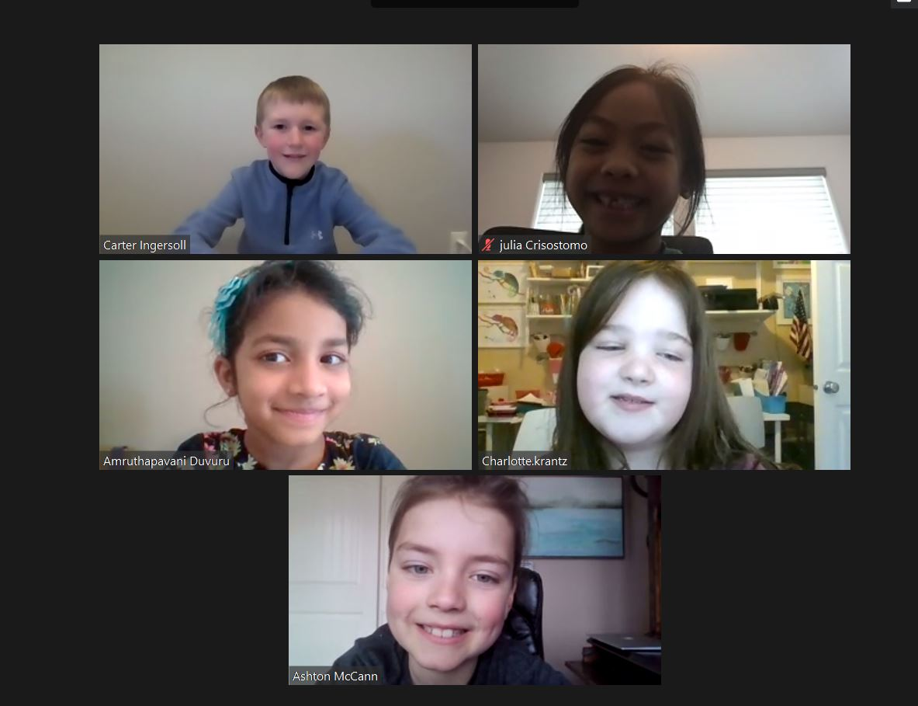

Slide 13
Technical Challenge
Elementary Level 5th Place
147-27466
Fuerza Rockets
Kennewick School District

Slide 14
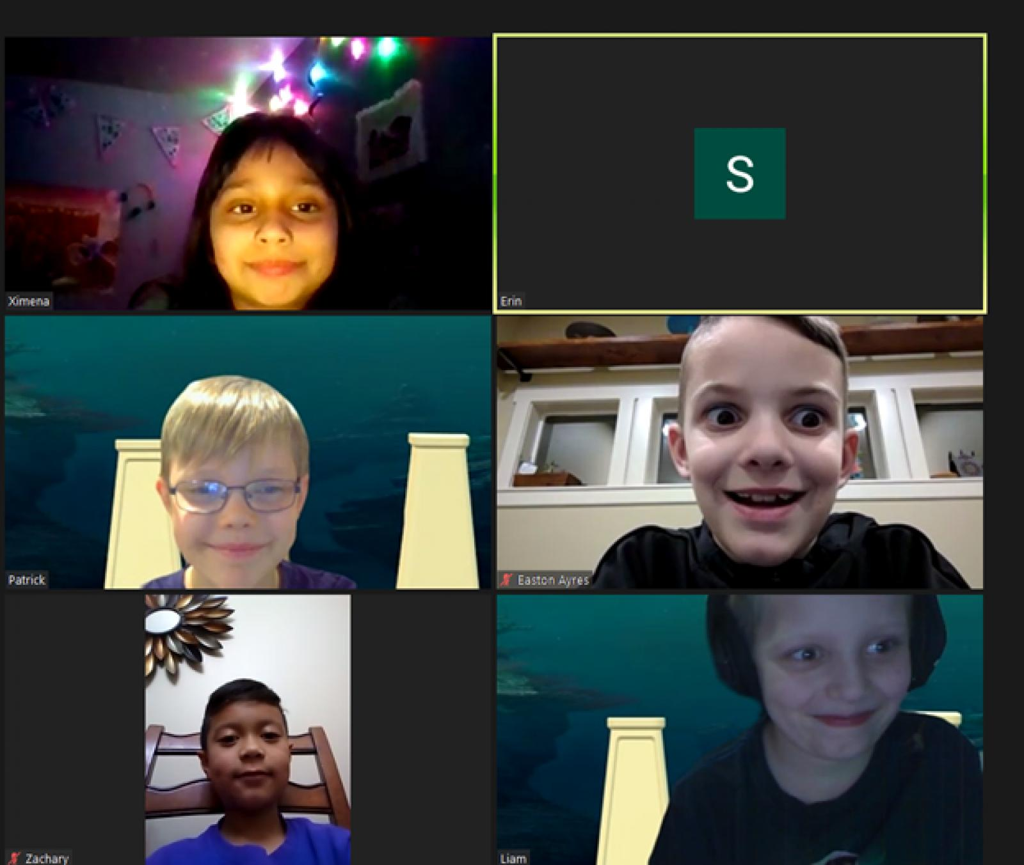

Slide 15
Technical Challenge
Elementary Level 4th Place
147-94551
The Nether Creepers
Orchard Elementary

Slide 16
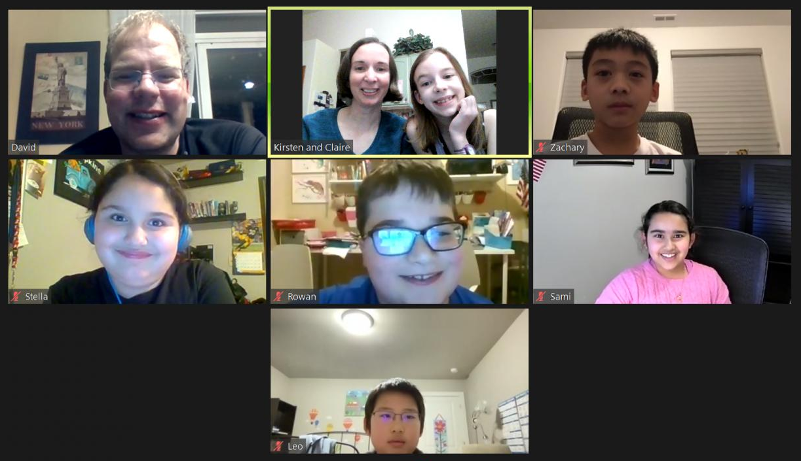

Slide 17
Technical Challenge
Elementary Level 3rd Place
147-40544
Team Tech
White Bluffs Elementary

Slide 18
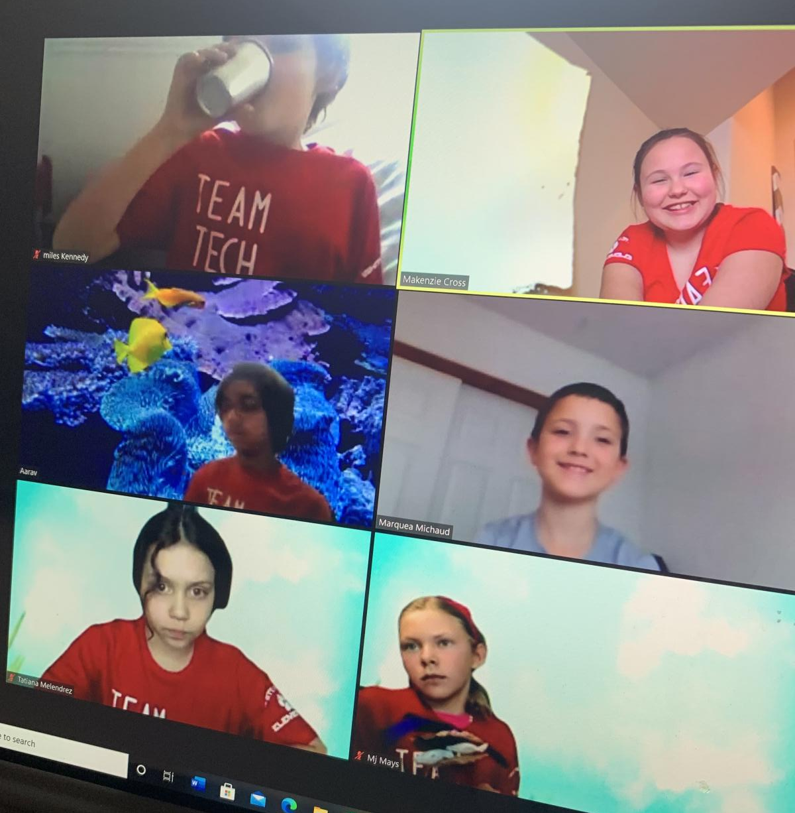

Slide 19
Technical Challenge
Elementary Level 2nd Place
147-18246
Challenge Conquerors
Lewis & Clark Elementary

Slide 20
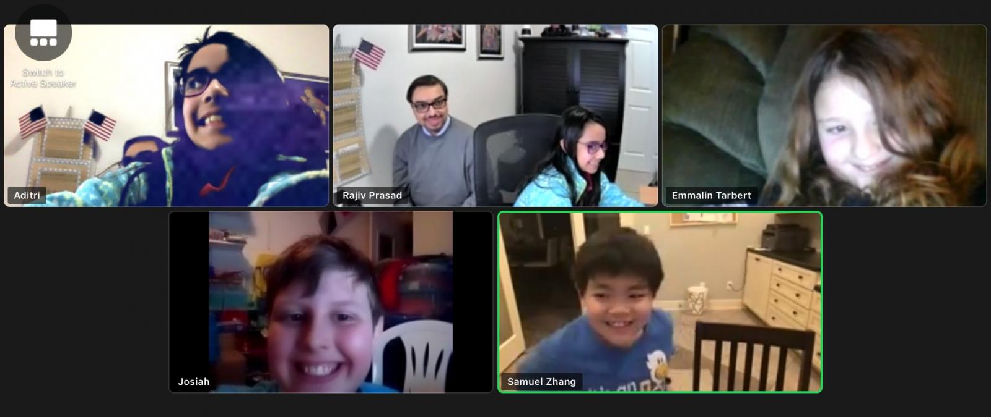

Slide 21
Technical Challenge
Elementary Level 1st Place
147-76793
I Don’t Have a Clue
Mid-Columbia Partnership

Slide 22
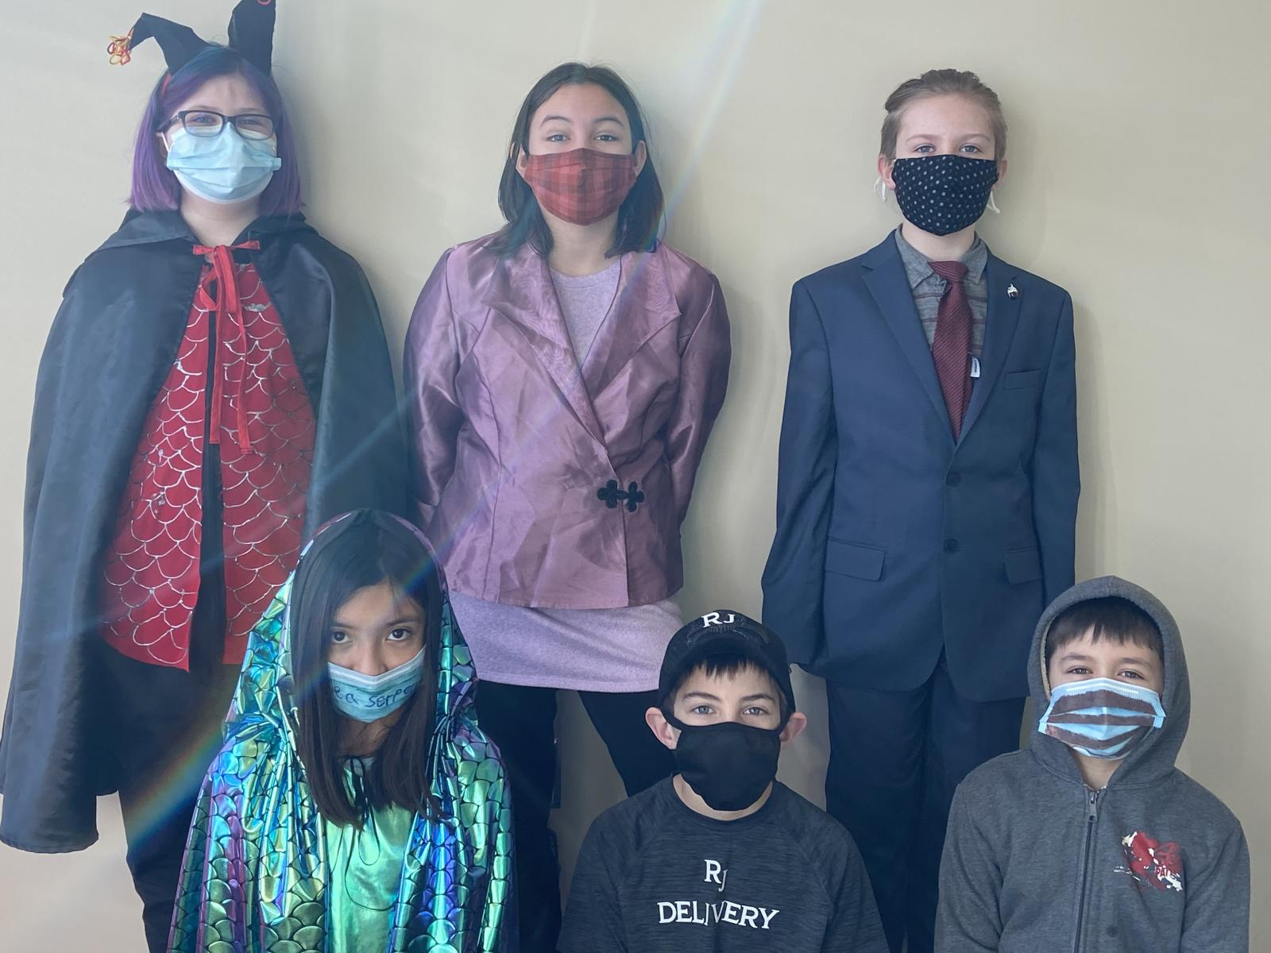

Slide 23
Technical Challenge
Middle Level 2nd Place
147-60117
Team Banana
Chief Joseph Middle School

Slide 24
Technical Challenge
Middle Level 1st Place
147-64486
I Can’t Pronounce This
Mid Columbia Partnership

Slide 25
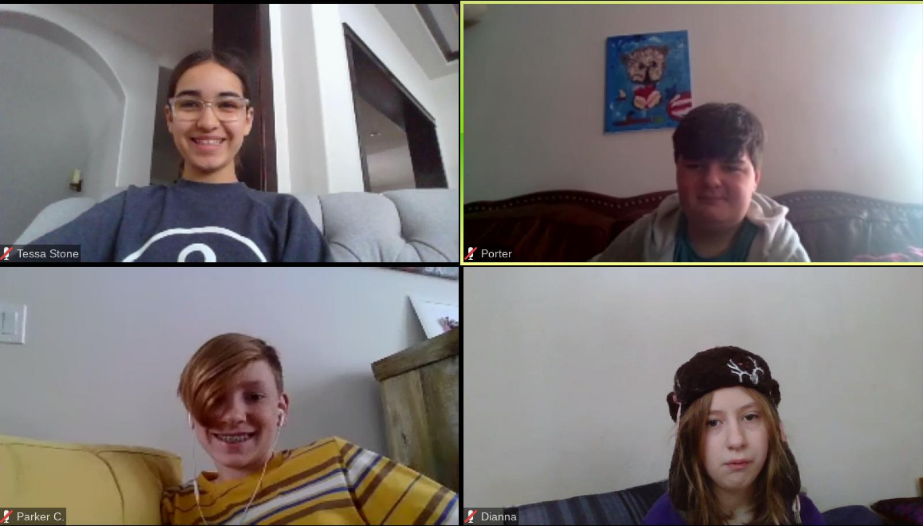

Slide 26
Amanda Lemley Regional Challenge Master

Slide 27
Scientific Challenge
Elementary Level 2nd Place
147-09342
Science Lawbreakers
Lewis & Clark Elementary

Slide 28
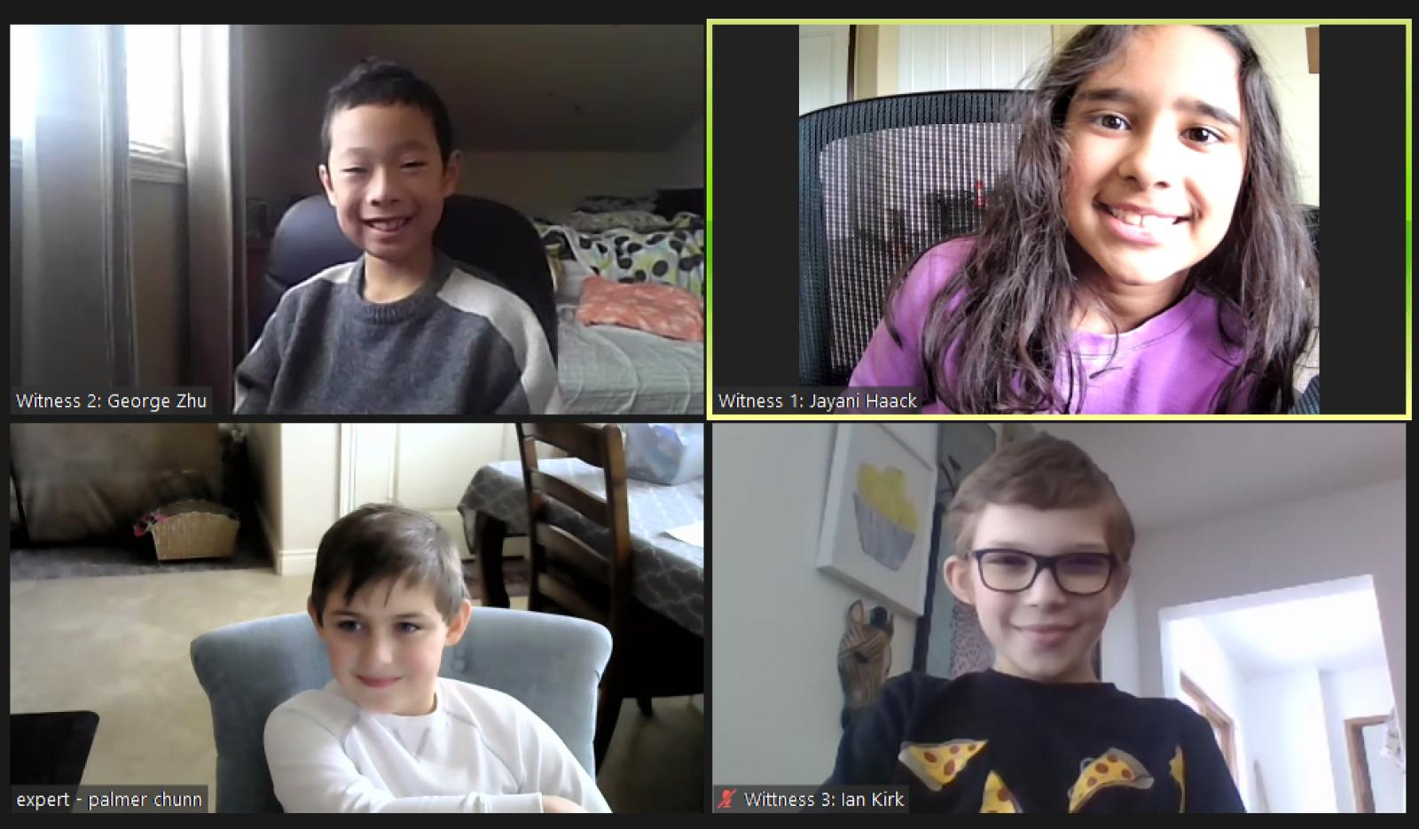

Slide 29
Scientific Challenge
Elementary Level 1st Place
147-63783
Atomic Wolfpack
Tapteal Elementary

Slide 30
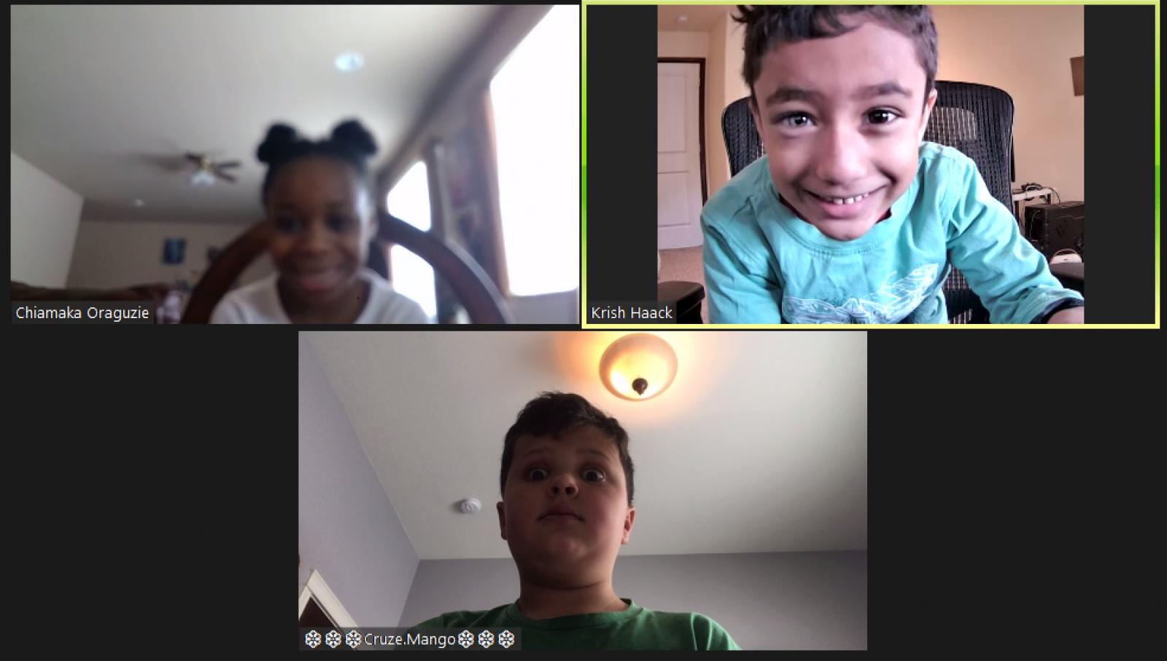
Tapteal

Slide 31
Scientific Challenge
Secondary Level 2nd Place
147-13644
Creative Chaotic Crew
Gonzaga Prep

Slide 32
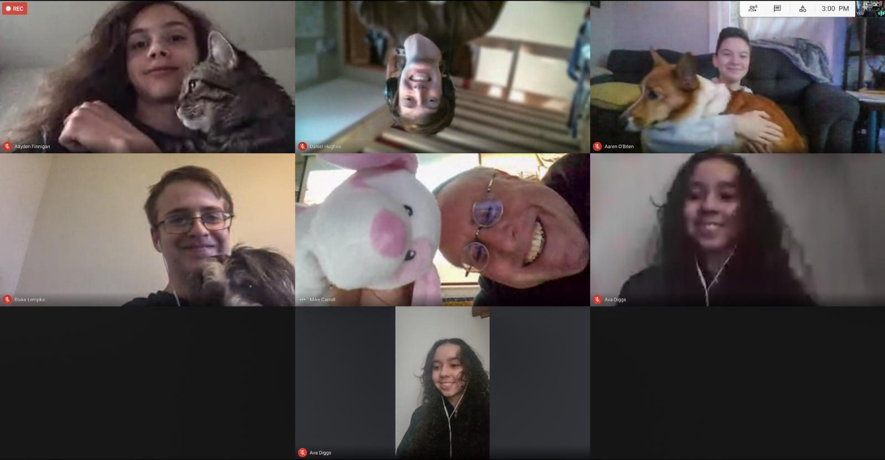
Gonzaga

Slide 33
Scientific Challenge
Secondary Level 1st Place
147-60816
Criminal Quad Squad
Lakeside High School

Slide 34
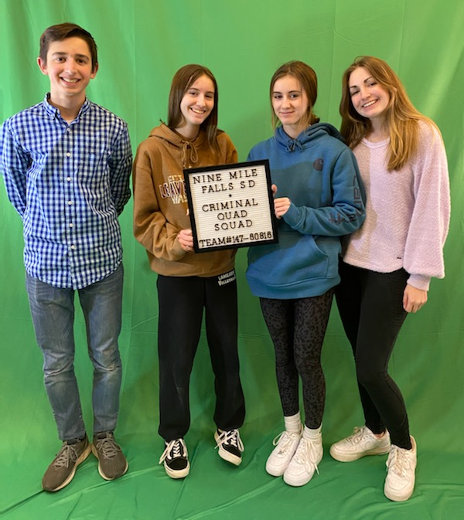
Nine Mile Falls

Slide 35
Christina Perry Regional Challenge Master

Slide 36
Fine Arts Challenge
Elementary Level 2nd Place
147-44770
Story Book Legend
Jason Lee & Marcus Whitman Elementary

Slide 37
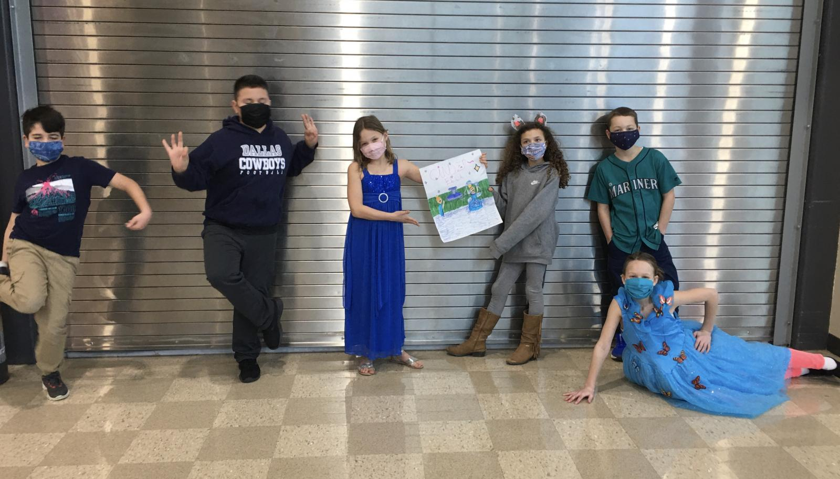

Slide 38
Fine Arts Challenge
Elementary Level 1st Place
147-10681
Creative Crayons
Orchard Elementary

Slide 39
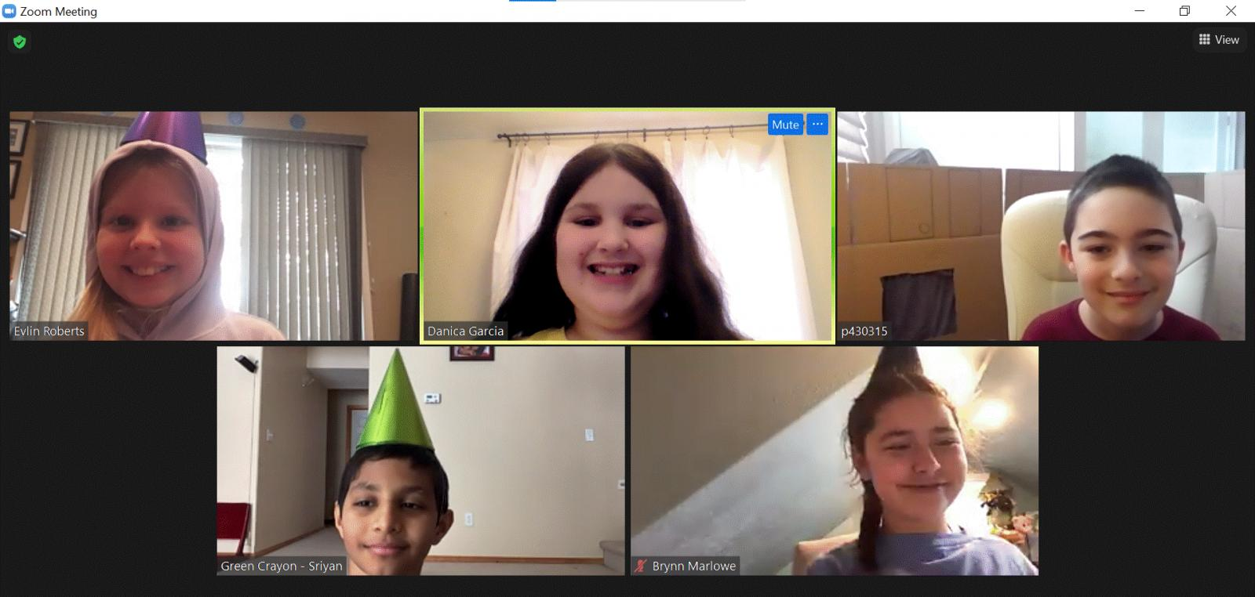

Slide 40
Fine Arts Challenge
Middle Level 1st Place
147-94074
The Cinco Amigos
Kennewick School District

Slide 41
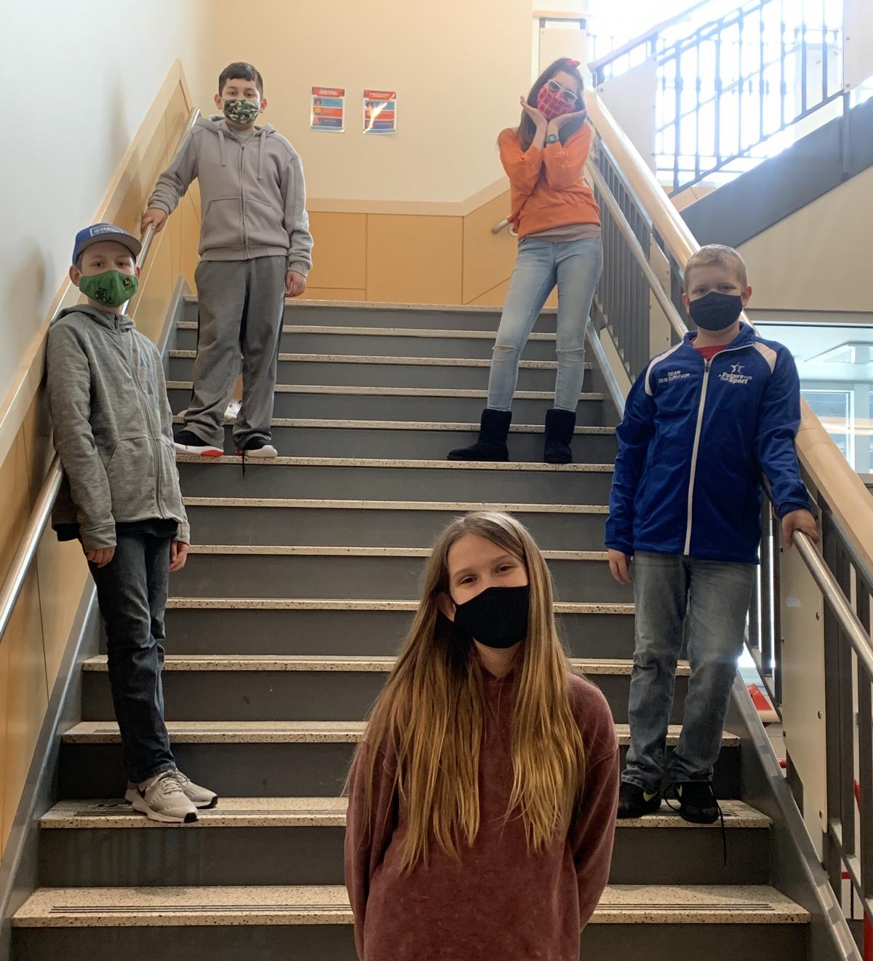

Slide 42
Shelley Skaar Regional Challenge Master

Slide 43
Improvisational Challenge
Elementary Level 2nd Place
147-94266
The Improv Impersonators!
Lewis & Clark Elementary

Slide 44
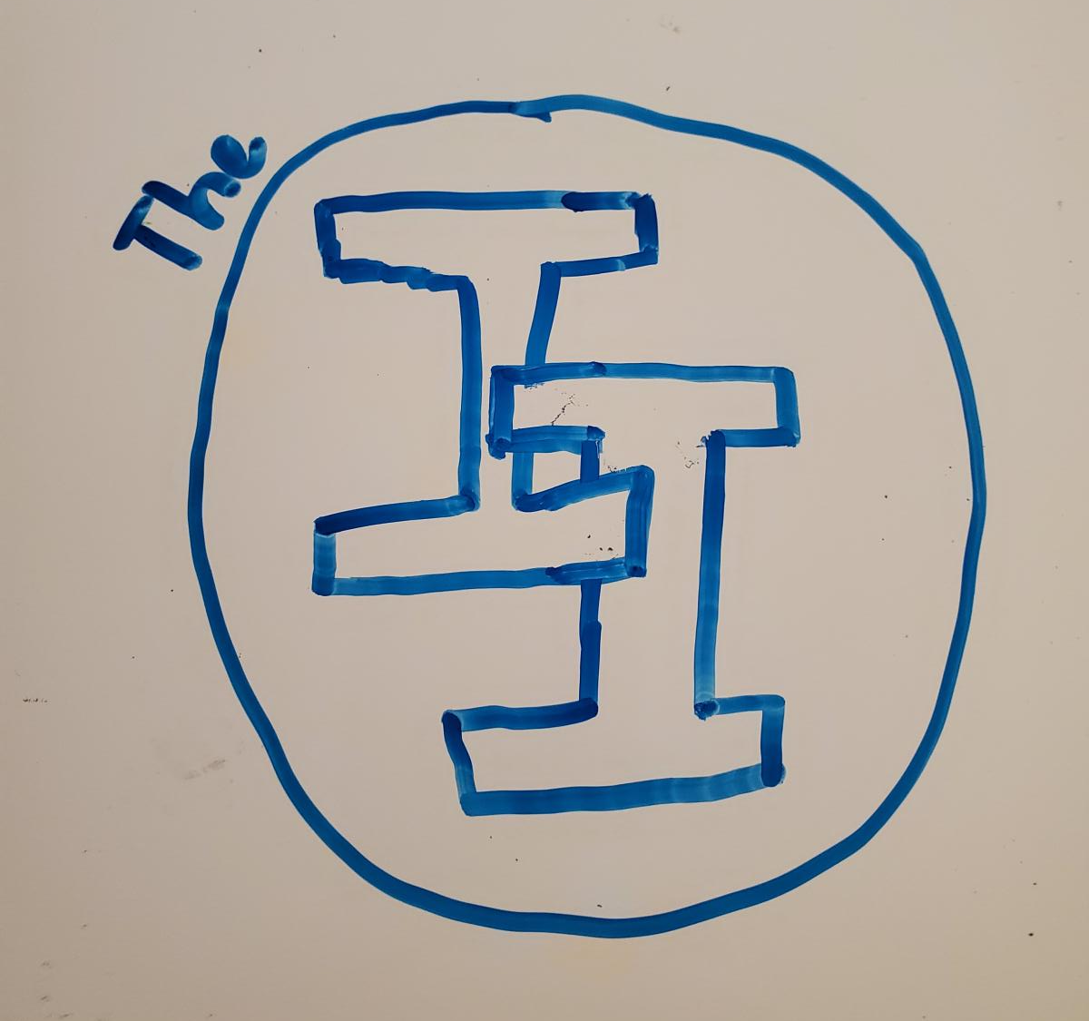

Slide 45
Improvisational Challenge
Elementary Level 1st Place
147-37391
Super Secret Sleuths
Badger Mountain & Jefferson Elementary

Slide 46
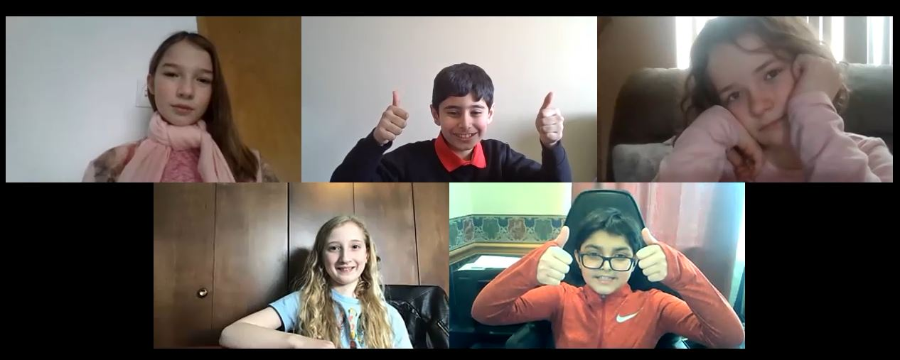

Slide 47
Improvisational Challenge
Secondary Level 1st Place
147-11648
JJASZAM
Kennewick School District

Slide 48
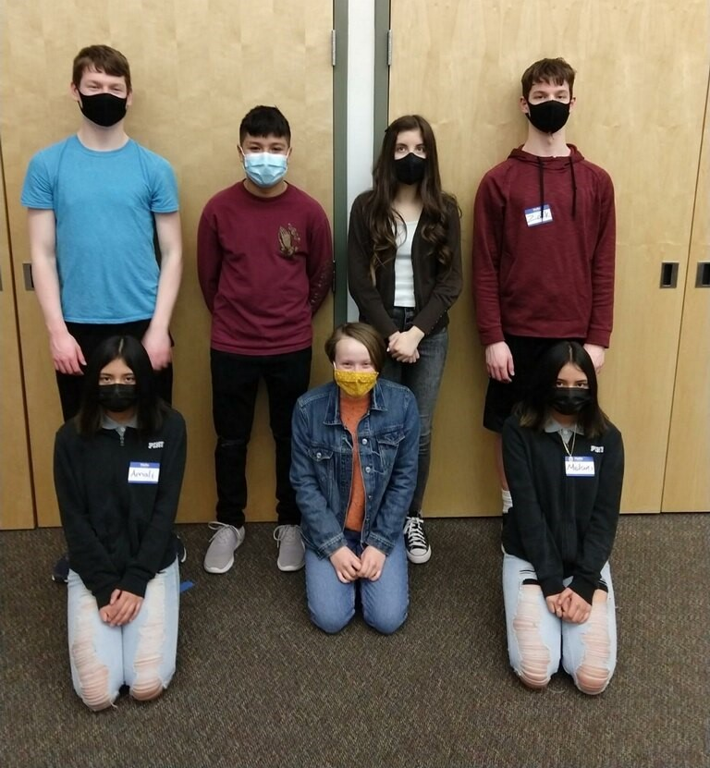

Slide 49
Lydia Schilling Regional Challenge Master

Slide 50
Service Learning Challenge
Elementary Level 1st Place
147-92322
TKEBIJ
Kennewick School District

Slide 51
Service Learning Challenge
Middle Level 1st Place
147-12647
Day Dreamers
Carmichael Middle School

Slide 52
Service Learning Challenge
Secondary Level 1st Place
147-96952
Fabled Five
Lakeside High School

Slide 53
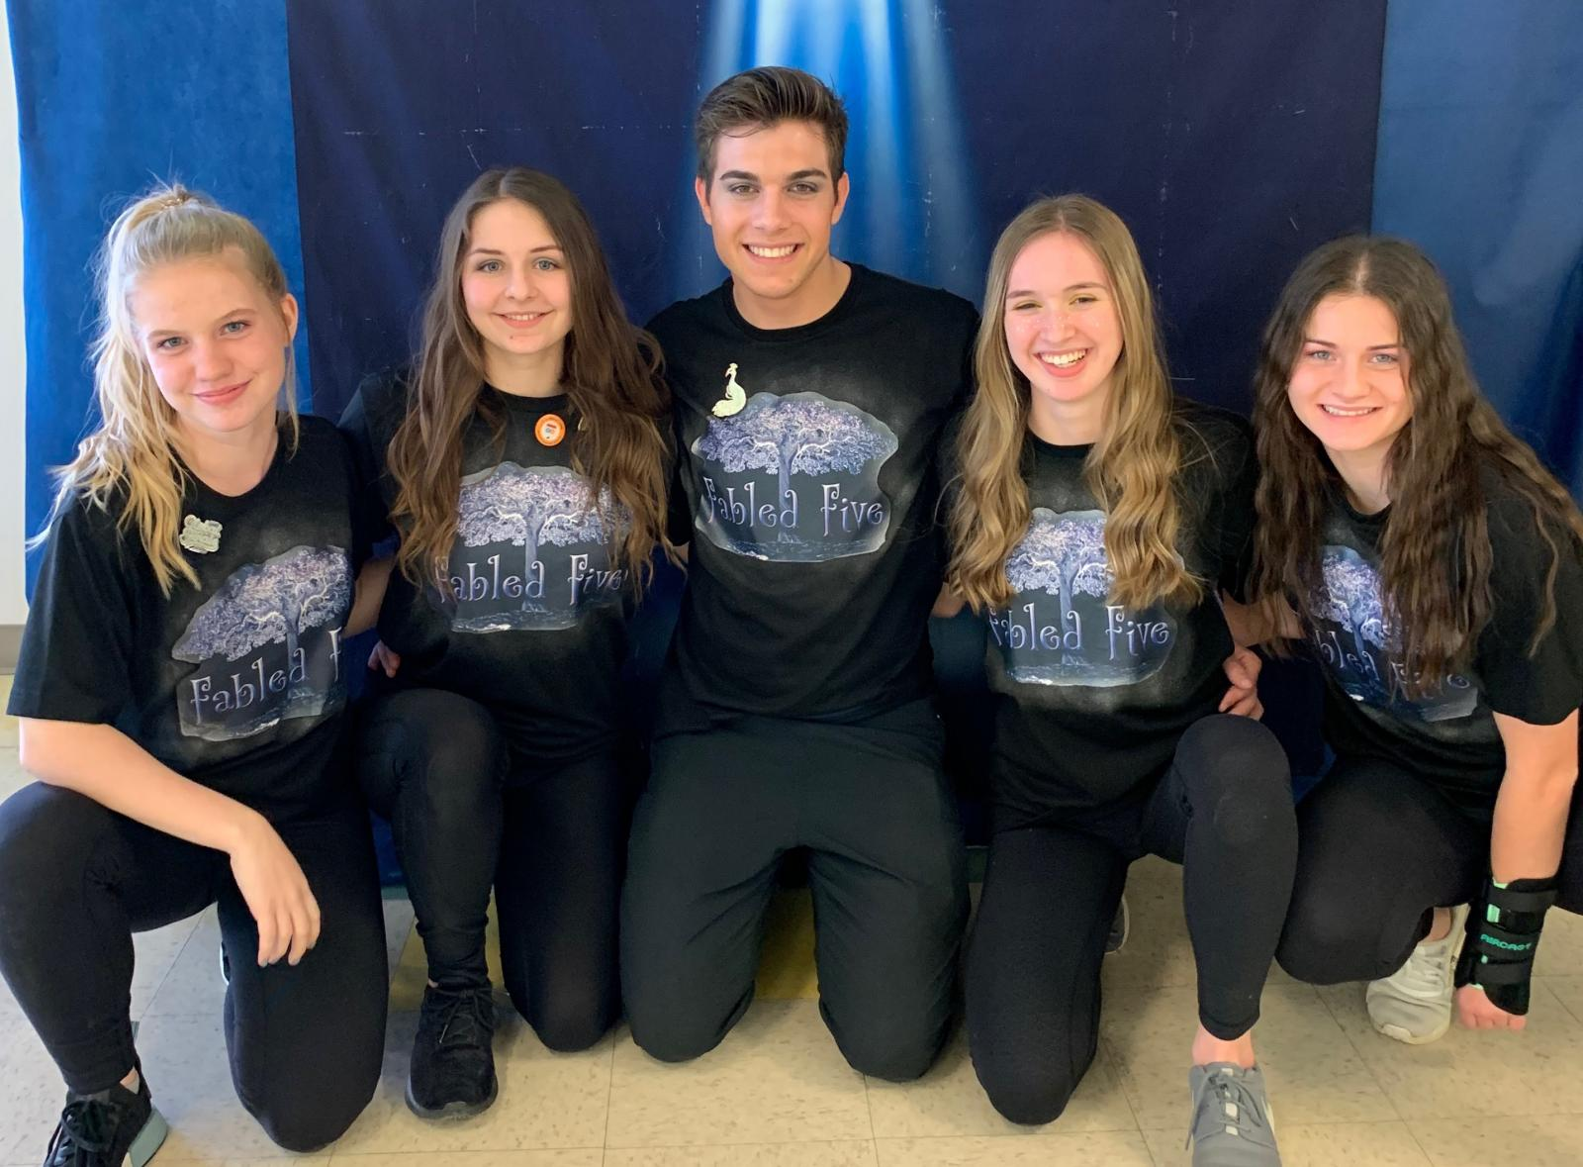

Slide 54
Renaissance Award
147-96952
Fabled Five
Lakeside High School

Slide 55
This award is offered for exceptional skill in the areas of engineering, design, or performance.
The appraisers wrote:
Beist thou presenting a wonderful story about a glorious project, we were duly impressed by the beautiful filming, delightful acting, and keen editing of this truly informative commercial that revealed so much more insight into the backstory of the intrinsic quirky character. Thanks!

Slide 56
Nicole Tamura Regional Challenge Master

Slide 57
Rising Stars Challenge
147-00783
The Narhwals
Jason Lee Elementary

Slide 58
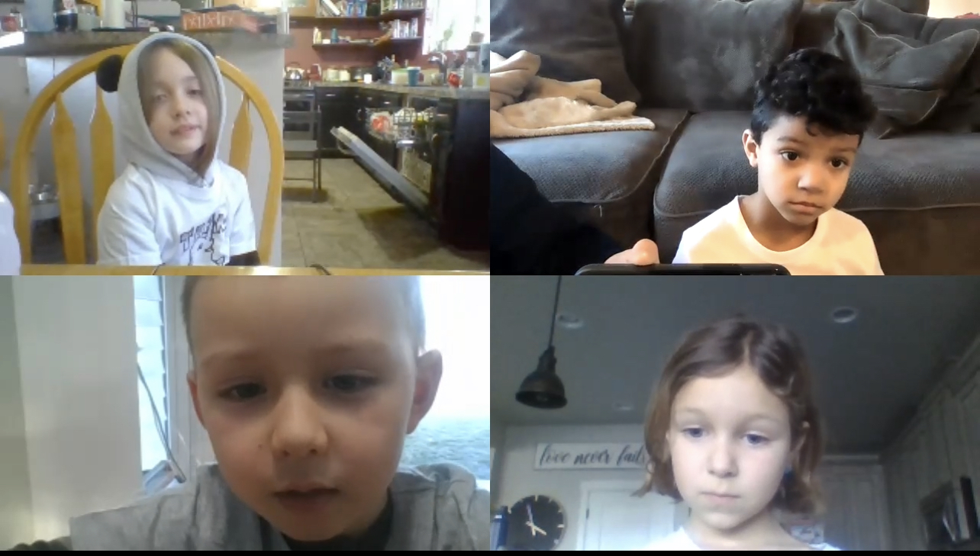

Slide 59
Rising Stars Challenge
147-02899
Critter Coop
Tapteal Elementary

Slide 60
Rising Stars Challenge
147-15132
The Really Fun Creators
Kennewick School District

Slide 61
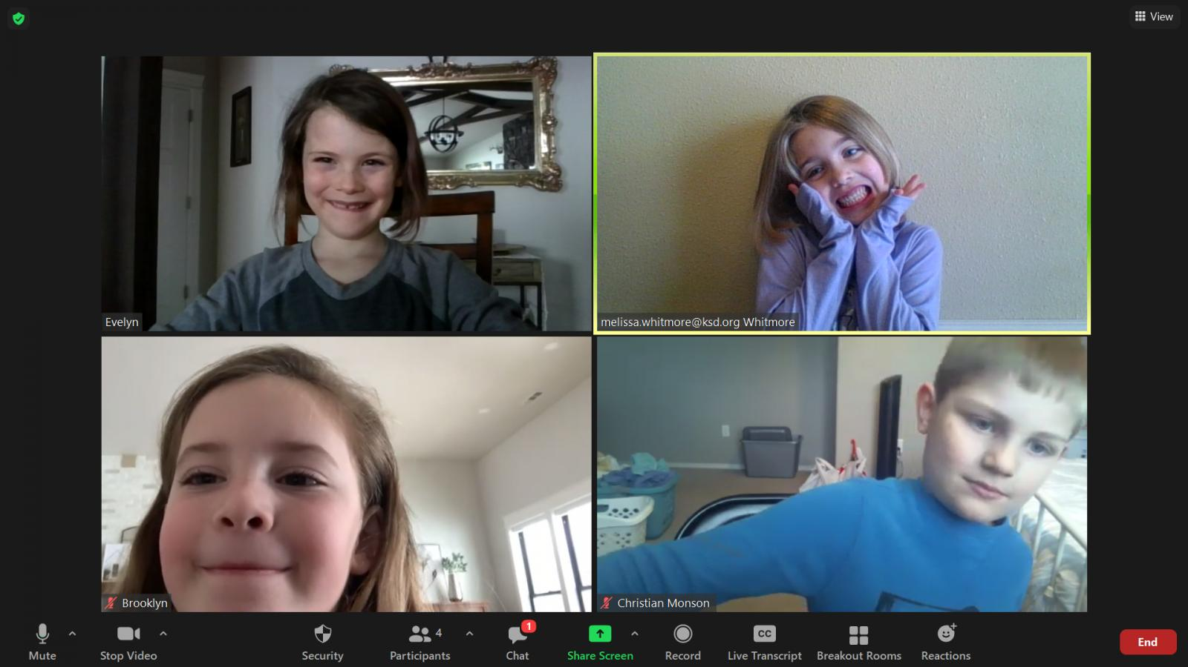

Slide 62
Rising Stars Challenge
147-39217
Puppy Cobras
White Bluffs Elementary

Slide 63
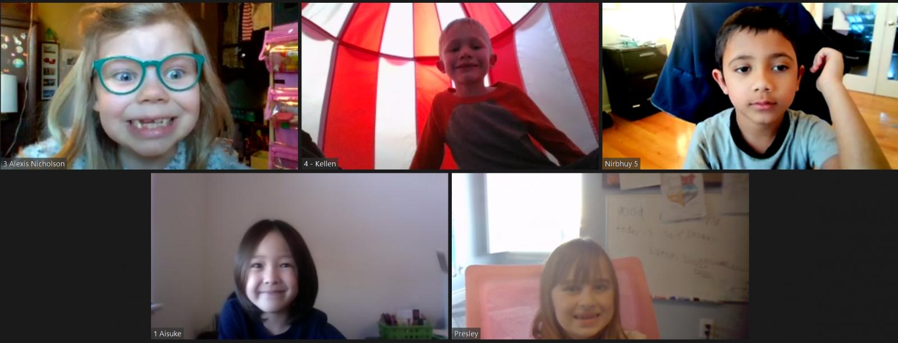

Slide 64
Rising Stars Challenge
147-56677
Ultra Kittens
Kennewick School District

Slide 65
Rising Stars Challenge
147-65407
Popcorn Kittens
Sacajawea Elementary

Slide 67
Rising Stars Challenge
147-80840
The Smart Mice
Kennewick School District

Slide 68
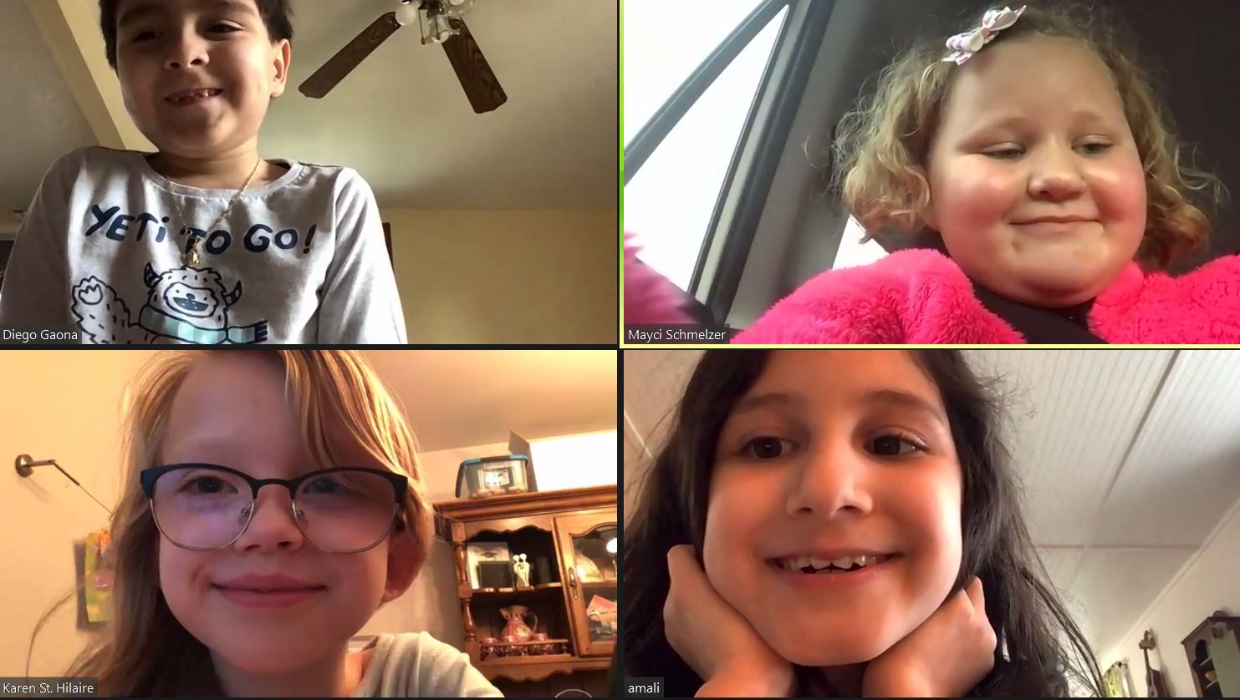

Slide 69
Spirit of DI Award
The Chin Family
George, Lori, Jackson
and Mickinley

Slide 70
George and Lori started as team managers for their son’s team at Badger Mtn. Elementary. They were team managers for 9 years, with teams advancing to Global Finals 8 of those years. George even drove a prop truck for WA teams from Richland to Knoxville!
After retiring as team managers, they volunteered as appraisers at regional and state tournaments. George became Eastern Regional Challenge Master for the Technical challenge and last year became our Affiliate Challenge Master. Lori served as Eastern Regional Tournament Director and helps conduct team manager and appraiser training.
Jackson and Mickinley, in addition to being team members for 9 & 8 years, have both volunteered as appraisers and tournament volunteers. While attending Global Finals as a team member, Jackson volunteered to help with set up and activities for Special Events.
A tournament cannot run without volunteers that exhibit a can-do spirit year after year. The Chin’s never cease to ask, “What can we do to help?” because they believe in the power of what Destination Imagination has taught their children.
This family exemplifies the true Spirit of DI.

Slide 71
Thank you for watching!
Awards and certificates will be mailed to the Team Manager.
Please remember to Register for the WA Affiliate Tournament at ryt.destinationimagination.org
Registration Deadline is Thursday March 4th.
Thank you for participating in Destination Imagination!

